Slide 1
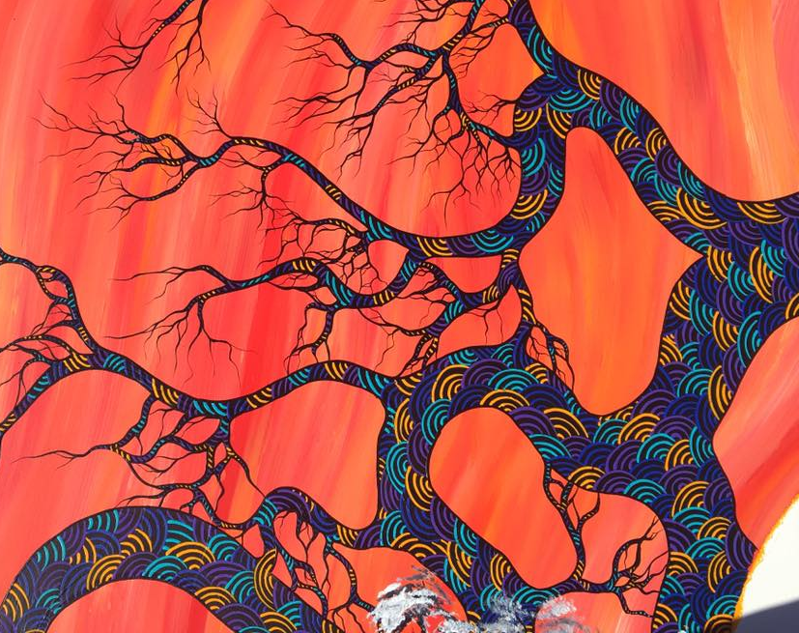
The aim of the FIRE (Friends Igniting Reconciliation through Education) Carrier Project is to promote respect, fairness and inclusion for Aboriginal people. The FIRE Carrier Project promotes enculturation and reconciliation in Sandhurst schools. The FIRE Carrier project Covenant is like a Reconciliation Action Plan.

Slide 2
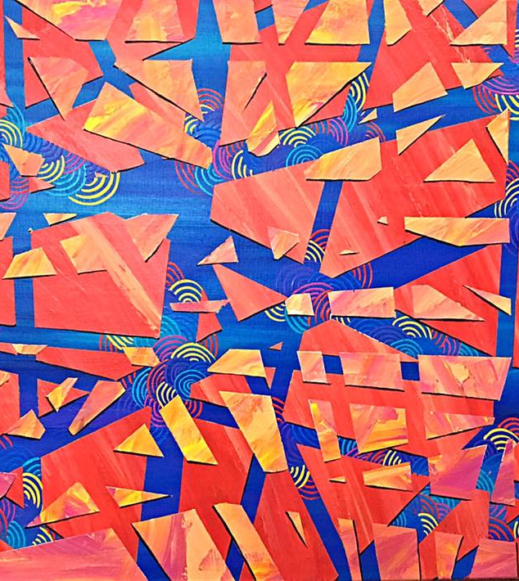
To be a FIRE Carrier is to exercise an important leadership role in the school community. FIRE carriers are students and teachers that share a passion for learning about Aboriginal culture and history and are committed to sharing this knowledge and promoting reconciliation within and beyond the school community.

Slide 3
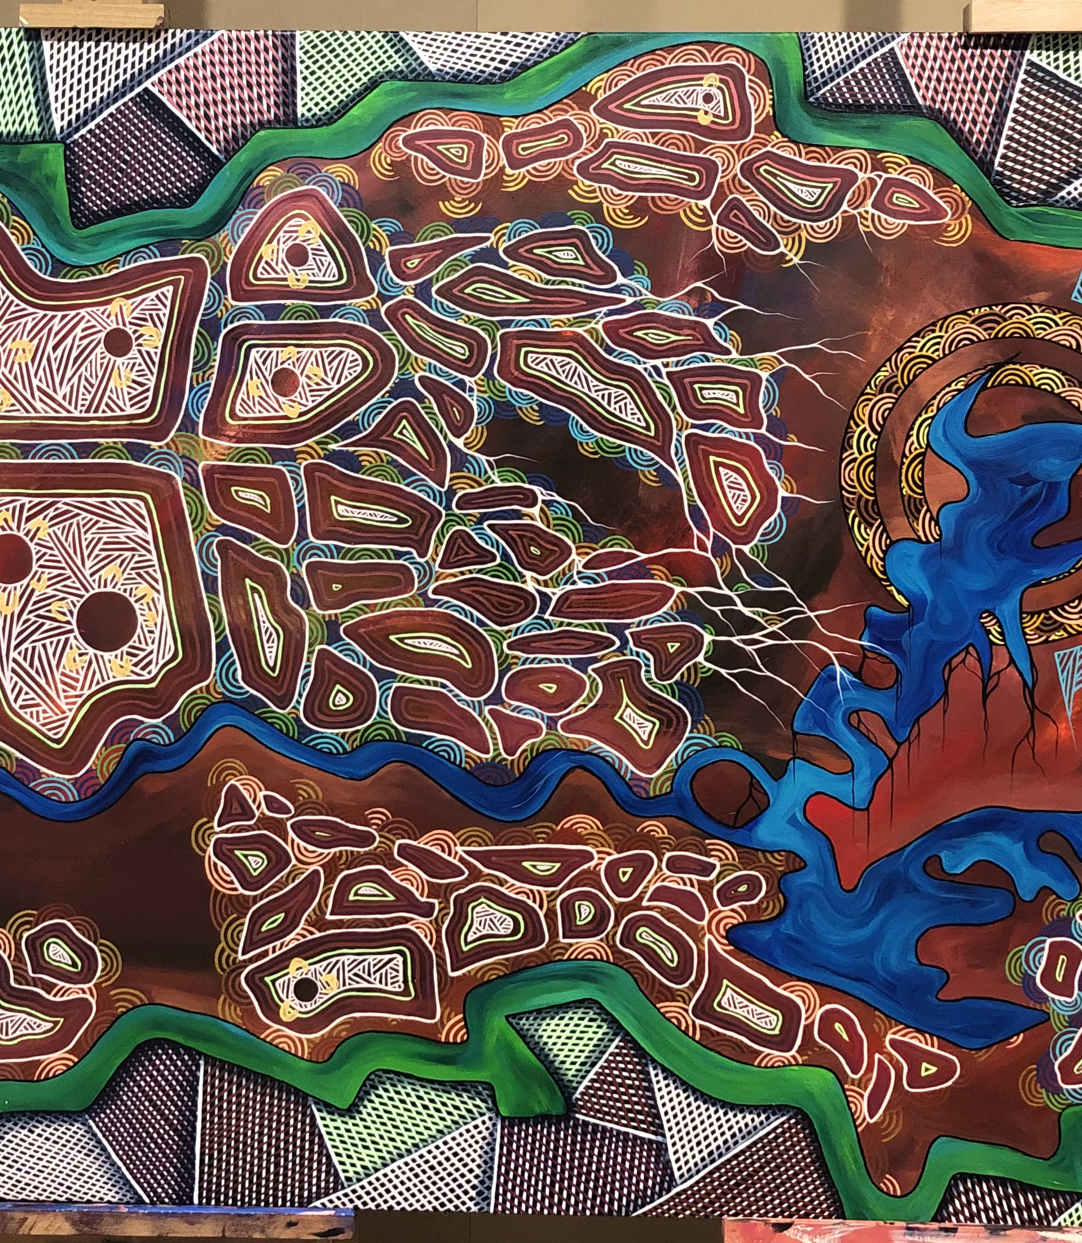
CHILD SAFE STANDARD 5.1 is fulfilled through the FIRE carrier covenant. All schools MUST have an up-to-date Covenant to fulfill this requirement.
Culturally safe environments
The schools take account of and make reasonable efforts to accommodate for the diversity of all children in implementing the Child Safe Standards relating to the following standard.
5.1 School premises must establish culturally safe environments in which the diverse and unique identities and experiences of Aboriginal children, young people, and students are respected and valued

Slide 4
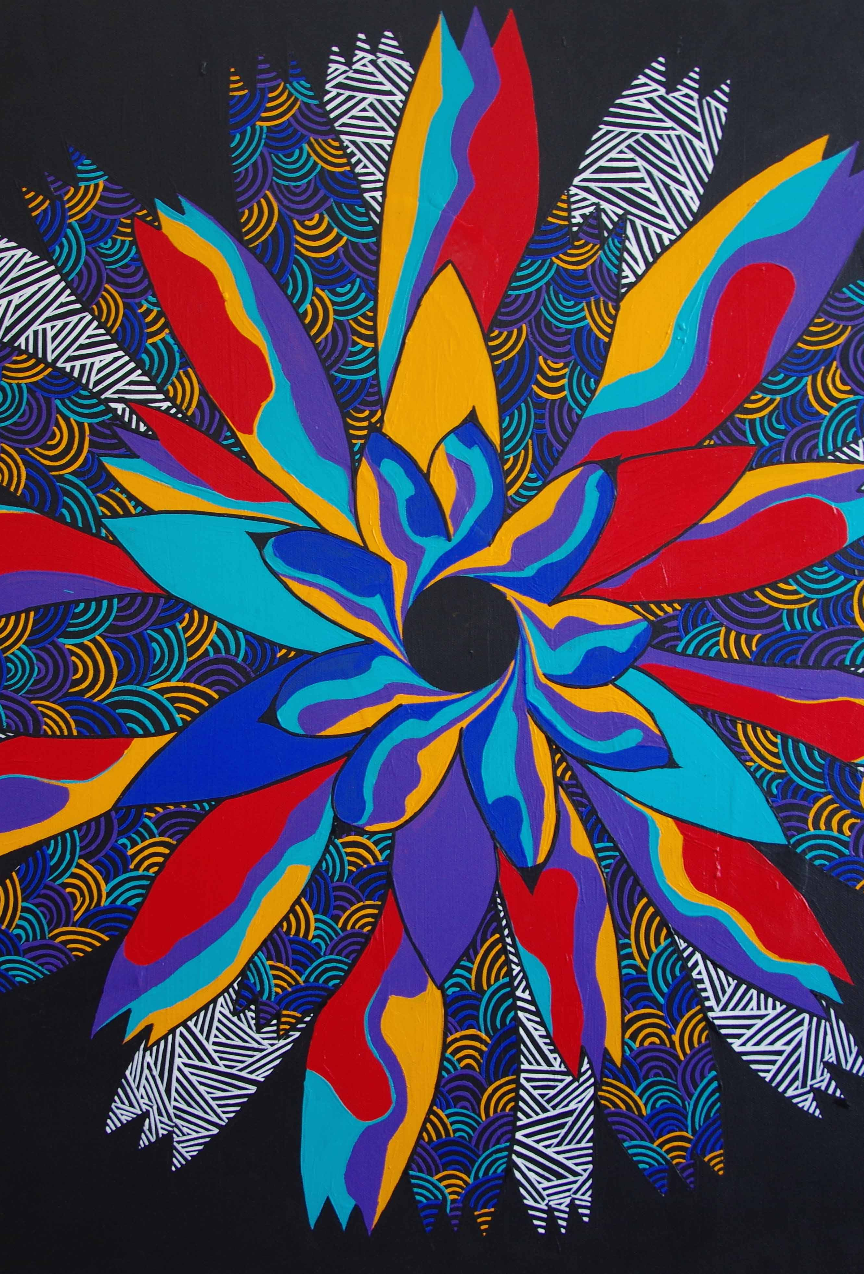
Actions
1. In endorsing and documenting the following activities contained within this FIRE Carrier covenant, Our School commits to completing or putting steps in place to complete all actions through measurable targets outlined by the dates set out in the timeline included.
2. This FIRE Carrier covenant will be made accessible on the school’s website to ensure adherence to the child safe standard referred to in the document.
3. A review at the end of the school year will be conducted and the plan will be updated and passed to the following year's FIRE Carrier coordinator?

Slide 5
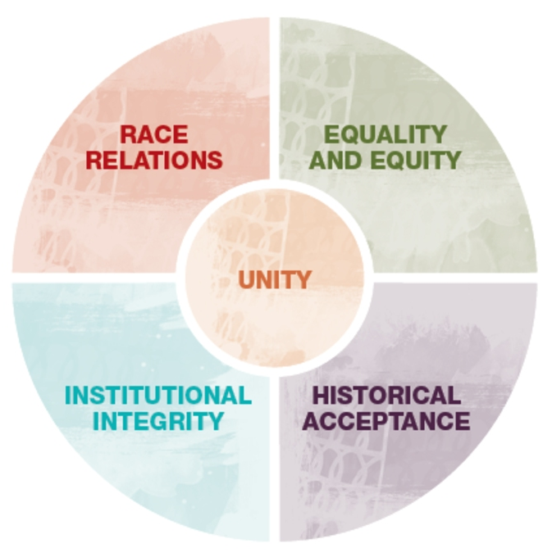

Slide 6
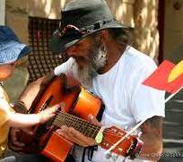
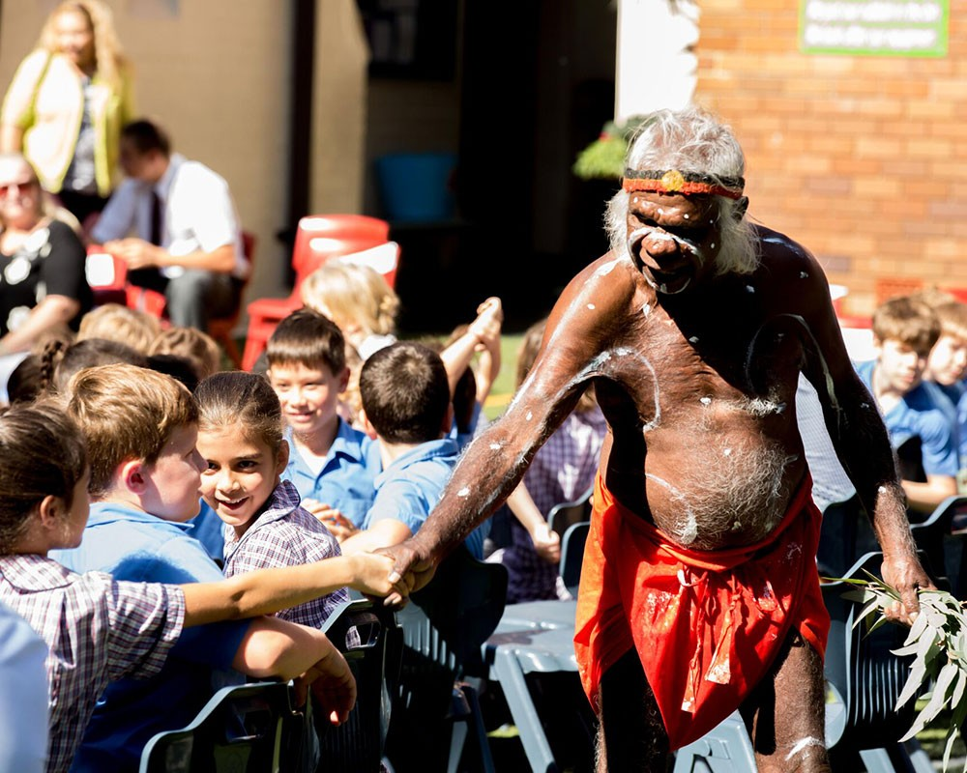

Slide 7
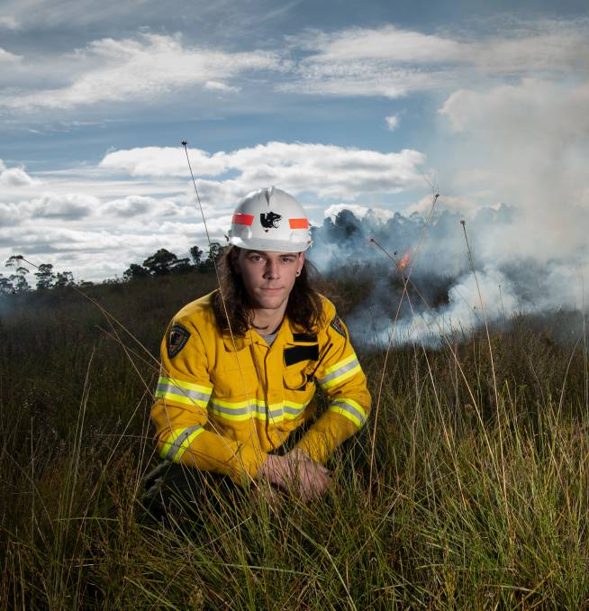


Slide 8
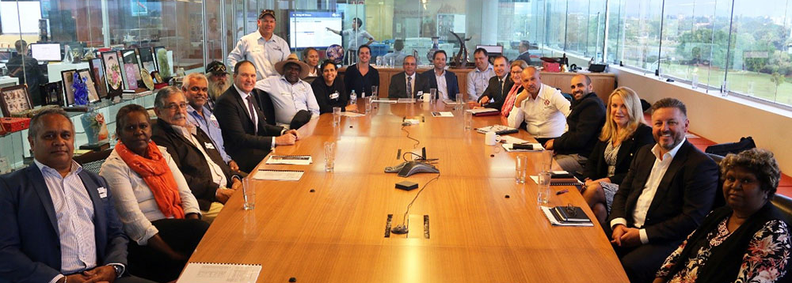
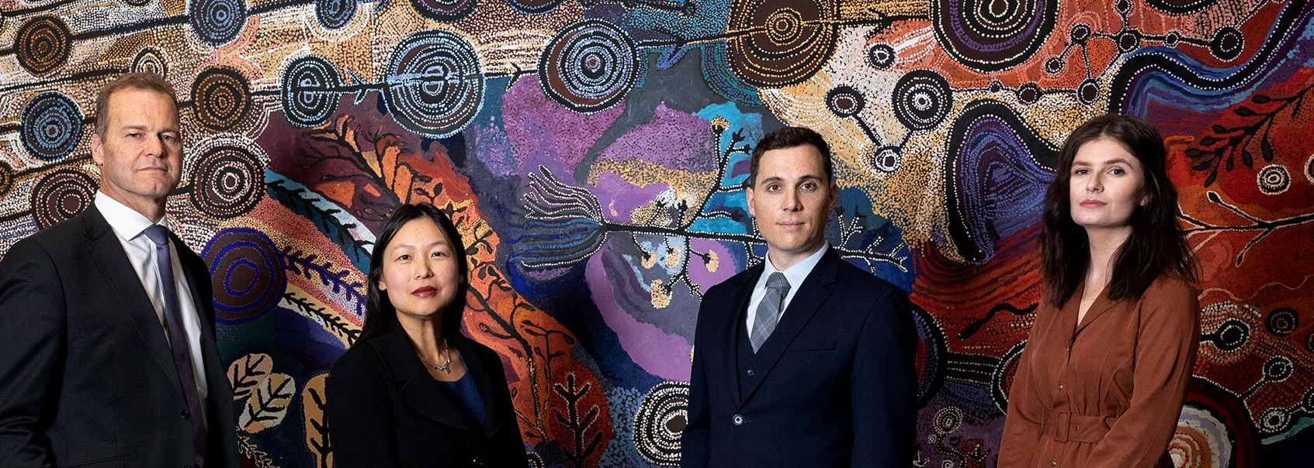

Slide 9
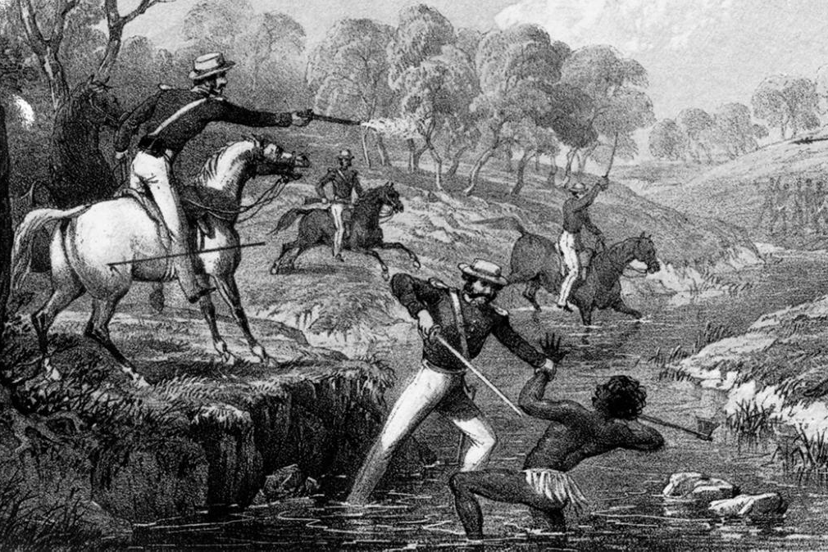

Slide 10
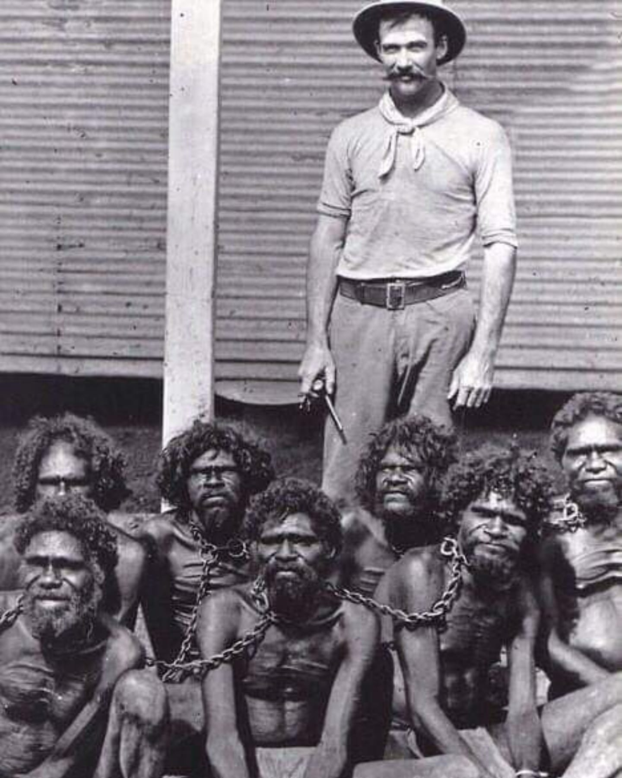
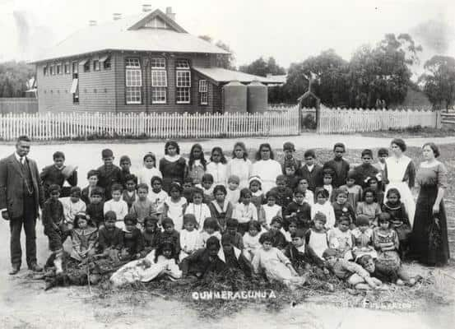

Slide 11
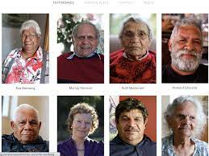

Slide 12
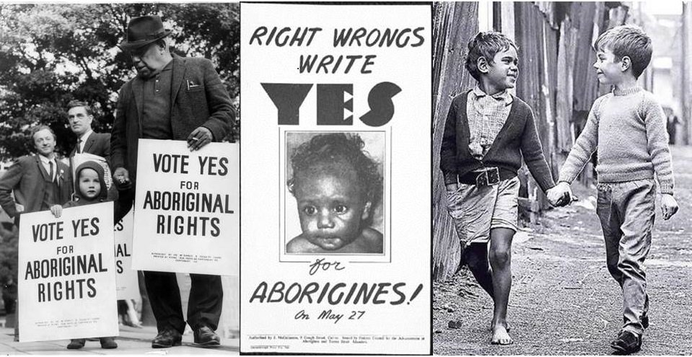

Slide 13
