Slide 1
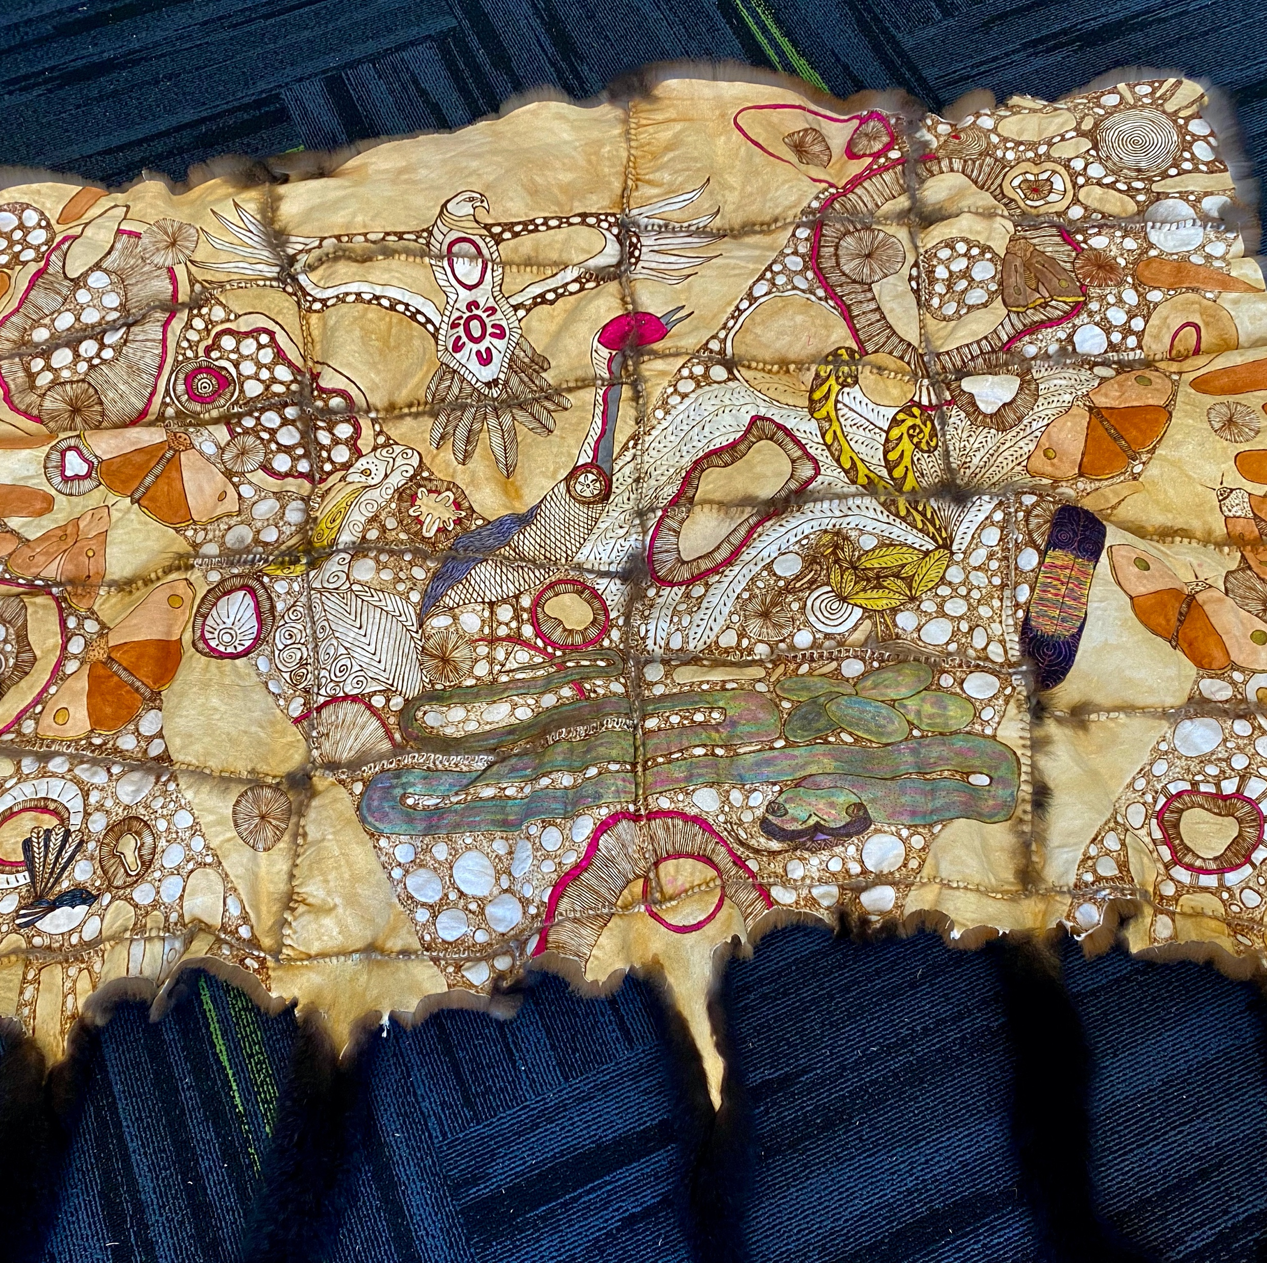
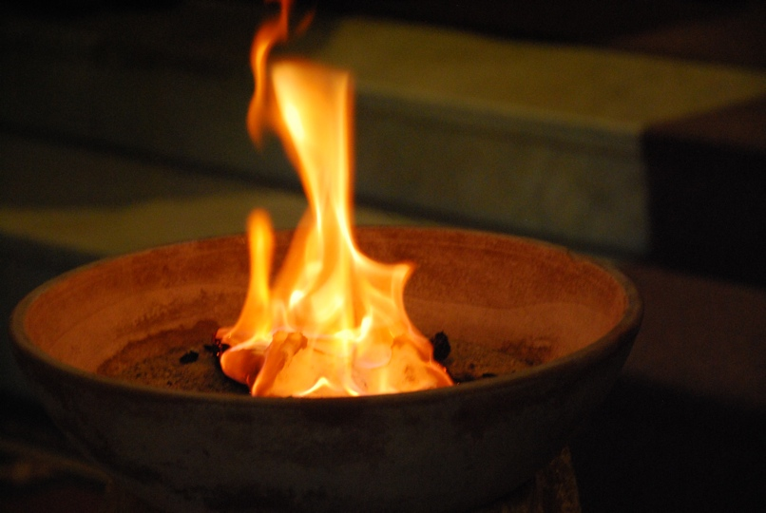

Acknowledgement of country
Today we acknowledge the traditional
Custodians of this place, the
Yorta Yorta Nation, including the 8
clan groups. We acknowledge the Elders both past, present and emerging and recognise that they have occupied and cared for this country over countless generations and we celebrate their continuing contribution to the life of this region.
Through this acknowledgement
We commit to seeing our country through Aboriginal eyes as we walk together in peace, harmony, justice and love.
Notes:
Can you name the 8 clan groups that belong to Yorta Yorta Nation?
Bangerang (Pangerang), Kaitheban, Wollithiga, Moira, Ulupna, Kwat Kwat, Yalaba Yalaba and Ngurai-illiam-wurrung,

Slide 2
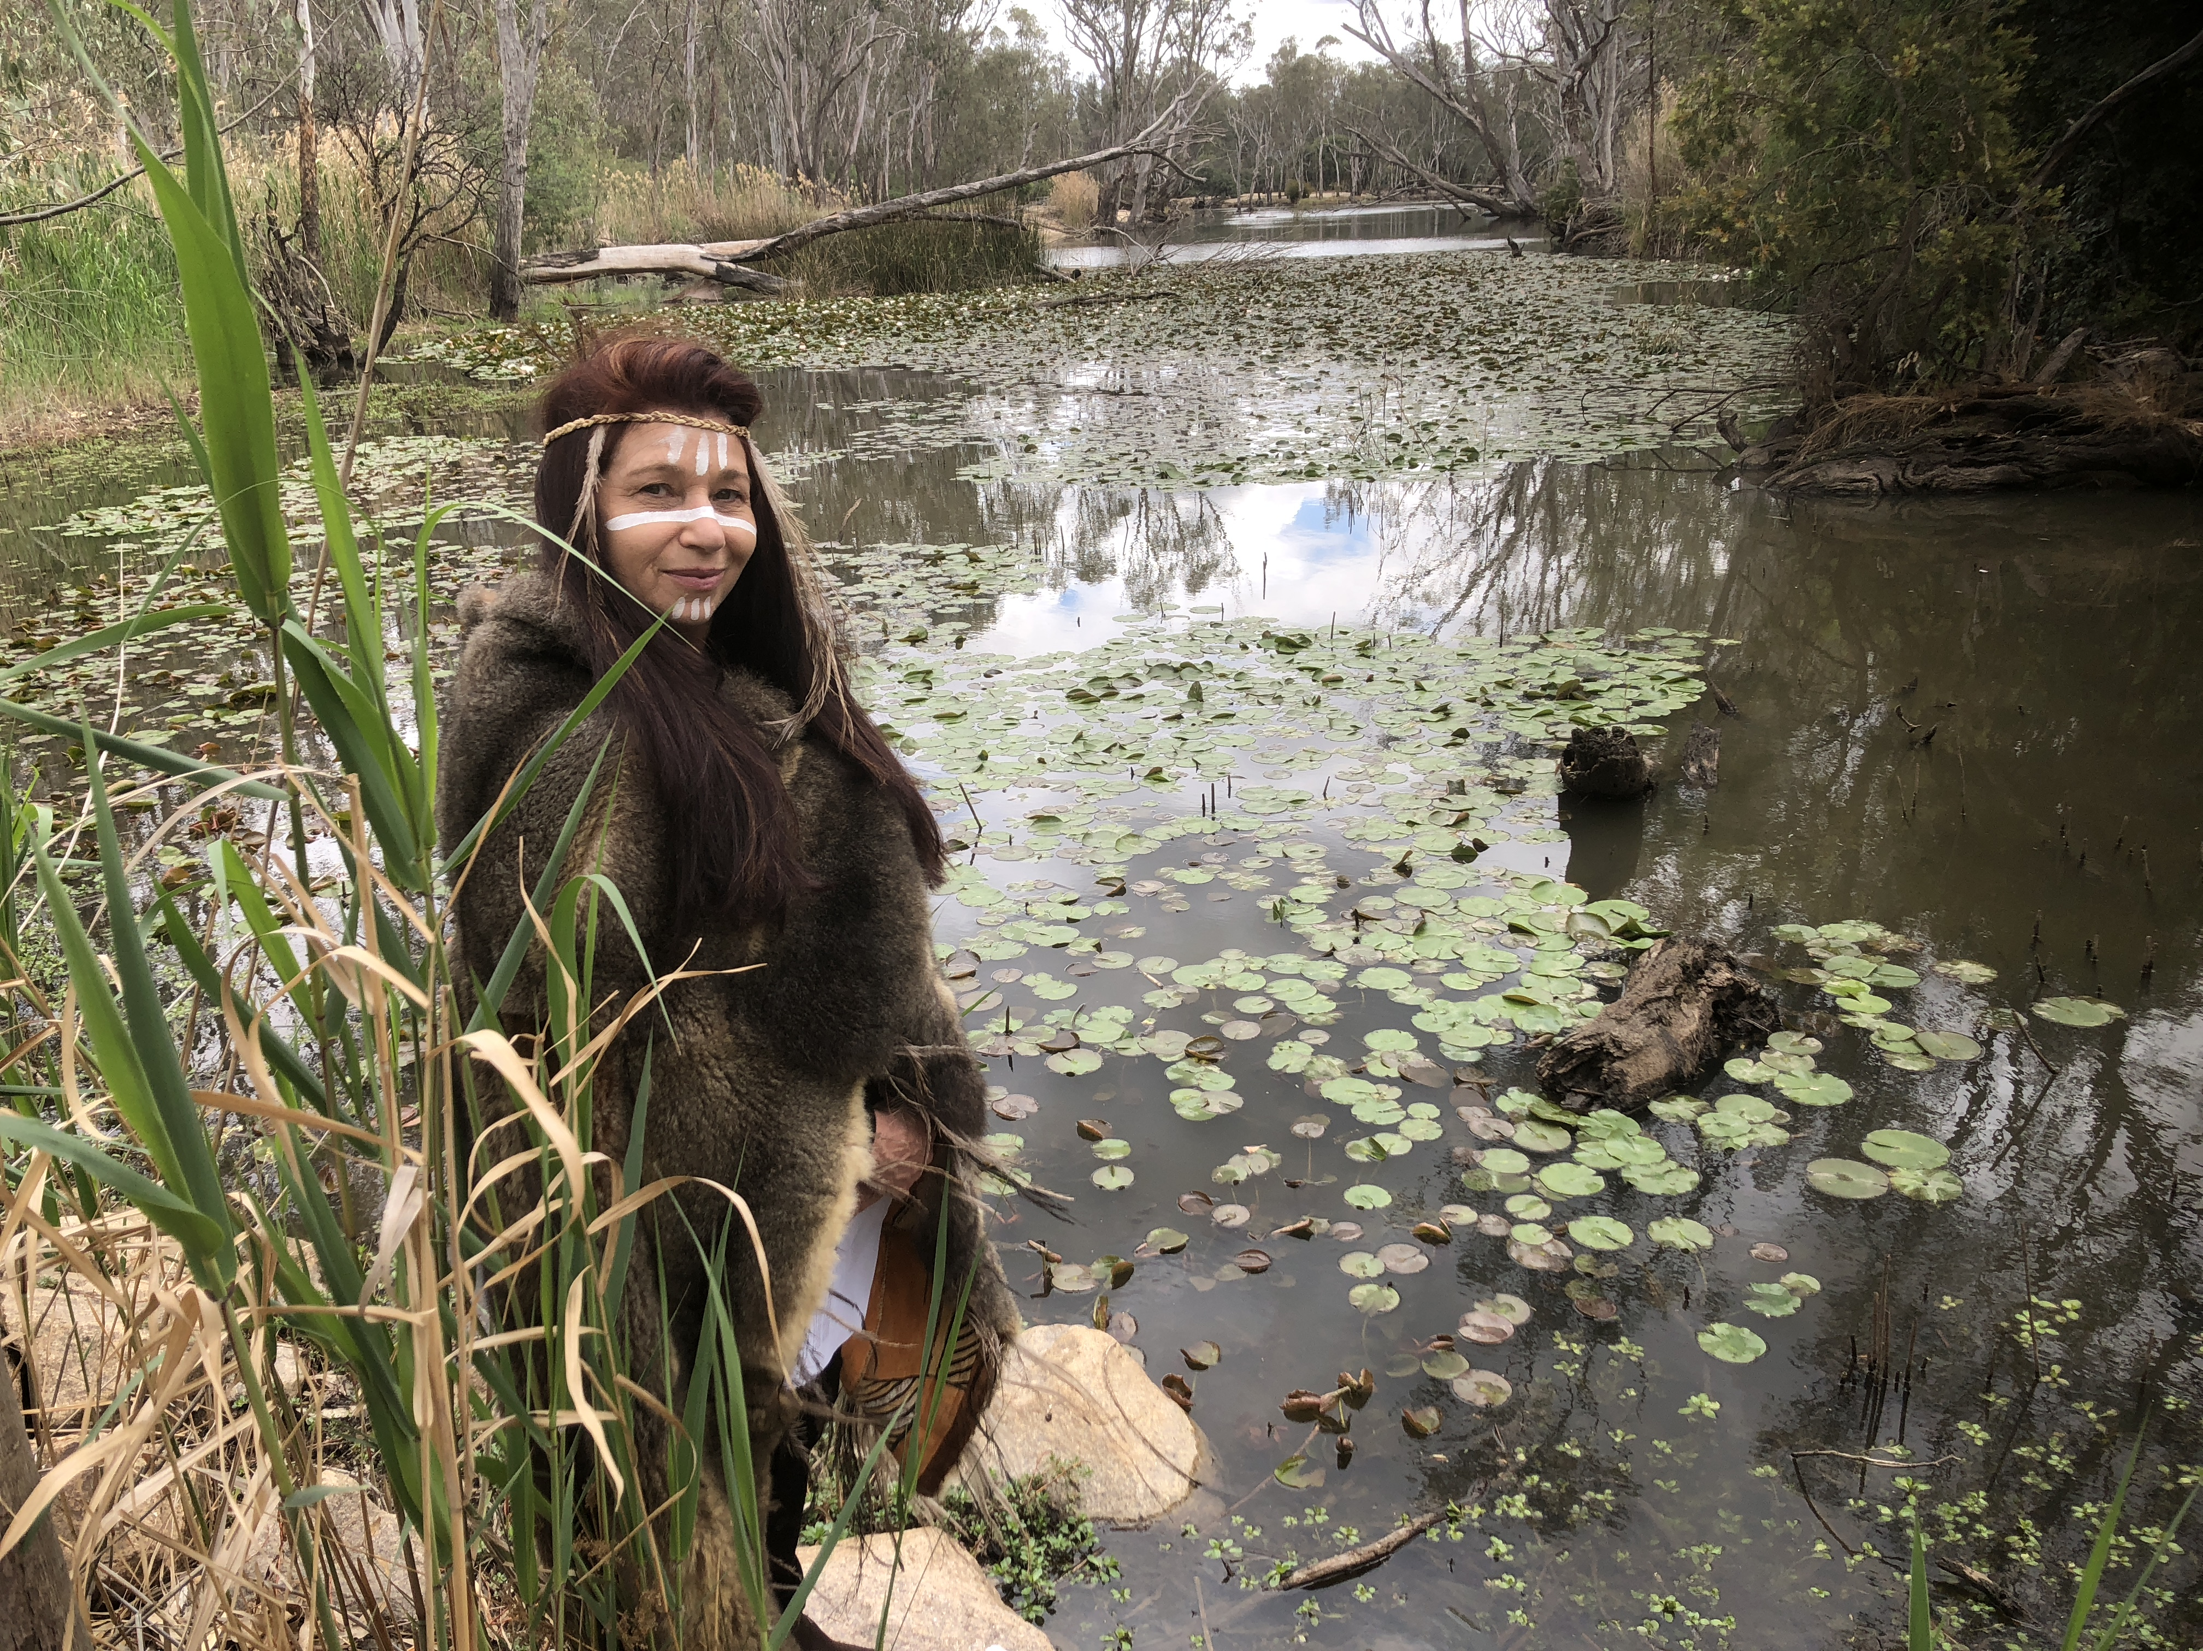
Acknowledgement of country
Today we’d like to acknowledge the Yorta Yorta Nation, inclusive of its eight clans.
We are thankful for the waterways, the lands, the clear skies and each other. We are thankful that the Yorta Yorta people cared so much for the land and that we can still be here today.
We pay our respect to elders, past and present for they hold the story and wisdom as we move towards a brighter future for all.
Here at St Patrick’s Tongala, we are rich in beauty, respect, courage, strength and kindliness, showing our gratitude and
empathy to the land as we care for it as the Aboriginal people traditionally do. We commit to walk side by side with First Nations people in a spirit of reconciliation, justice and healing.
Notes:
Can you name the 8 clan groups that belong to Yorta Yorta Nation?
Bangerang (Pangerang), Kaitheban, Wollithiga, Moira, Ulupna, Kwat Kwat, Yalaba Yalaba and Ngurai-illiam-wurrung,

Slide 3
FIRE of the new dreaming
Workshop
(friends igniting reconciliation through education)
Carry the Coals Fan the Flame
of Reconciliation!
Notes:
ANCIENT DREAMING.
We recognise the special place and culture of Aboriginal peoples within Australia. We acknowledge that Aboriginal peoples have been the caretakers of this Land for more than 60,000 years. We respect their spiritual connection to Mother Earth through the Dreaming.
They only took what they needed - they shared stories thru dance, song and drawings.
They performed age old ceremonies - like WtC

Slide 4
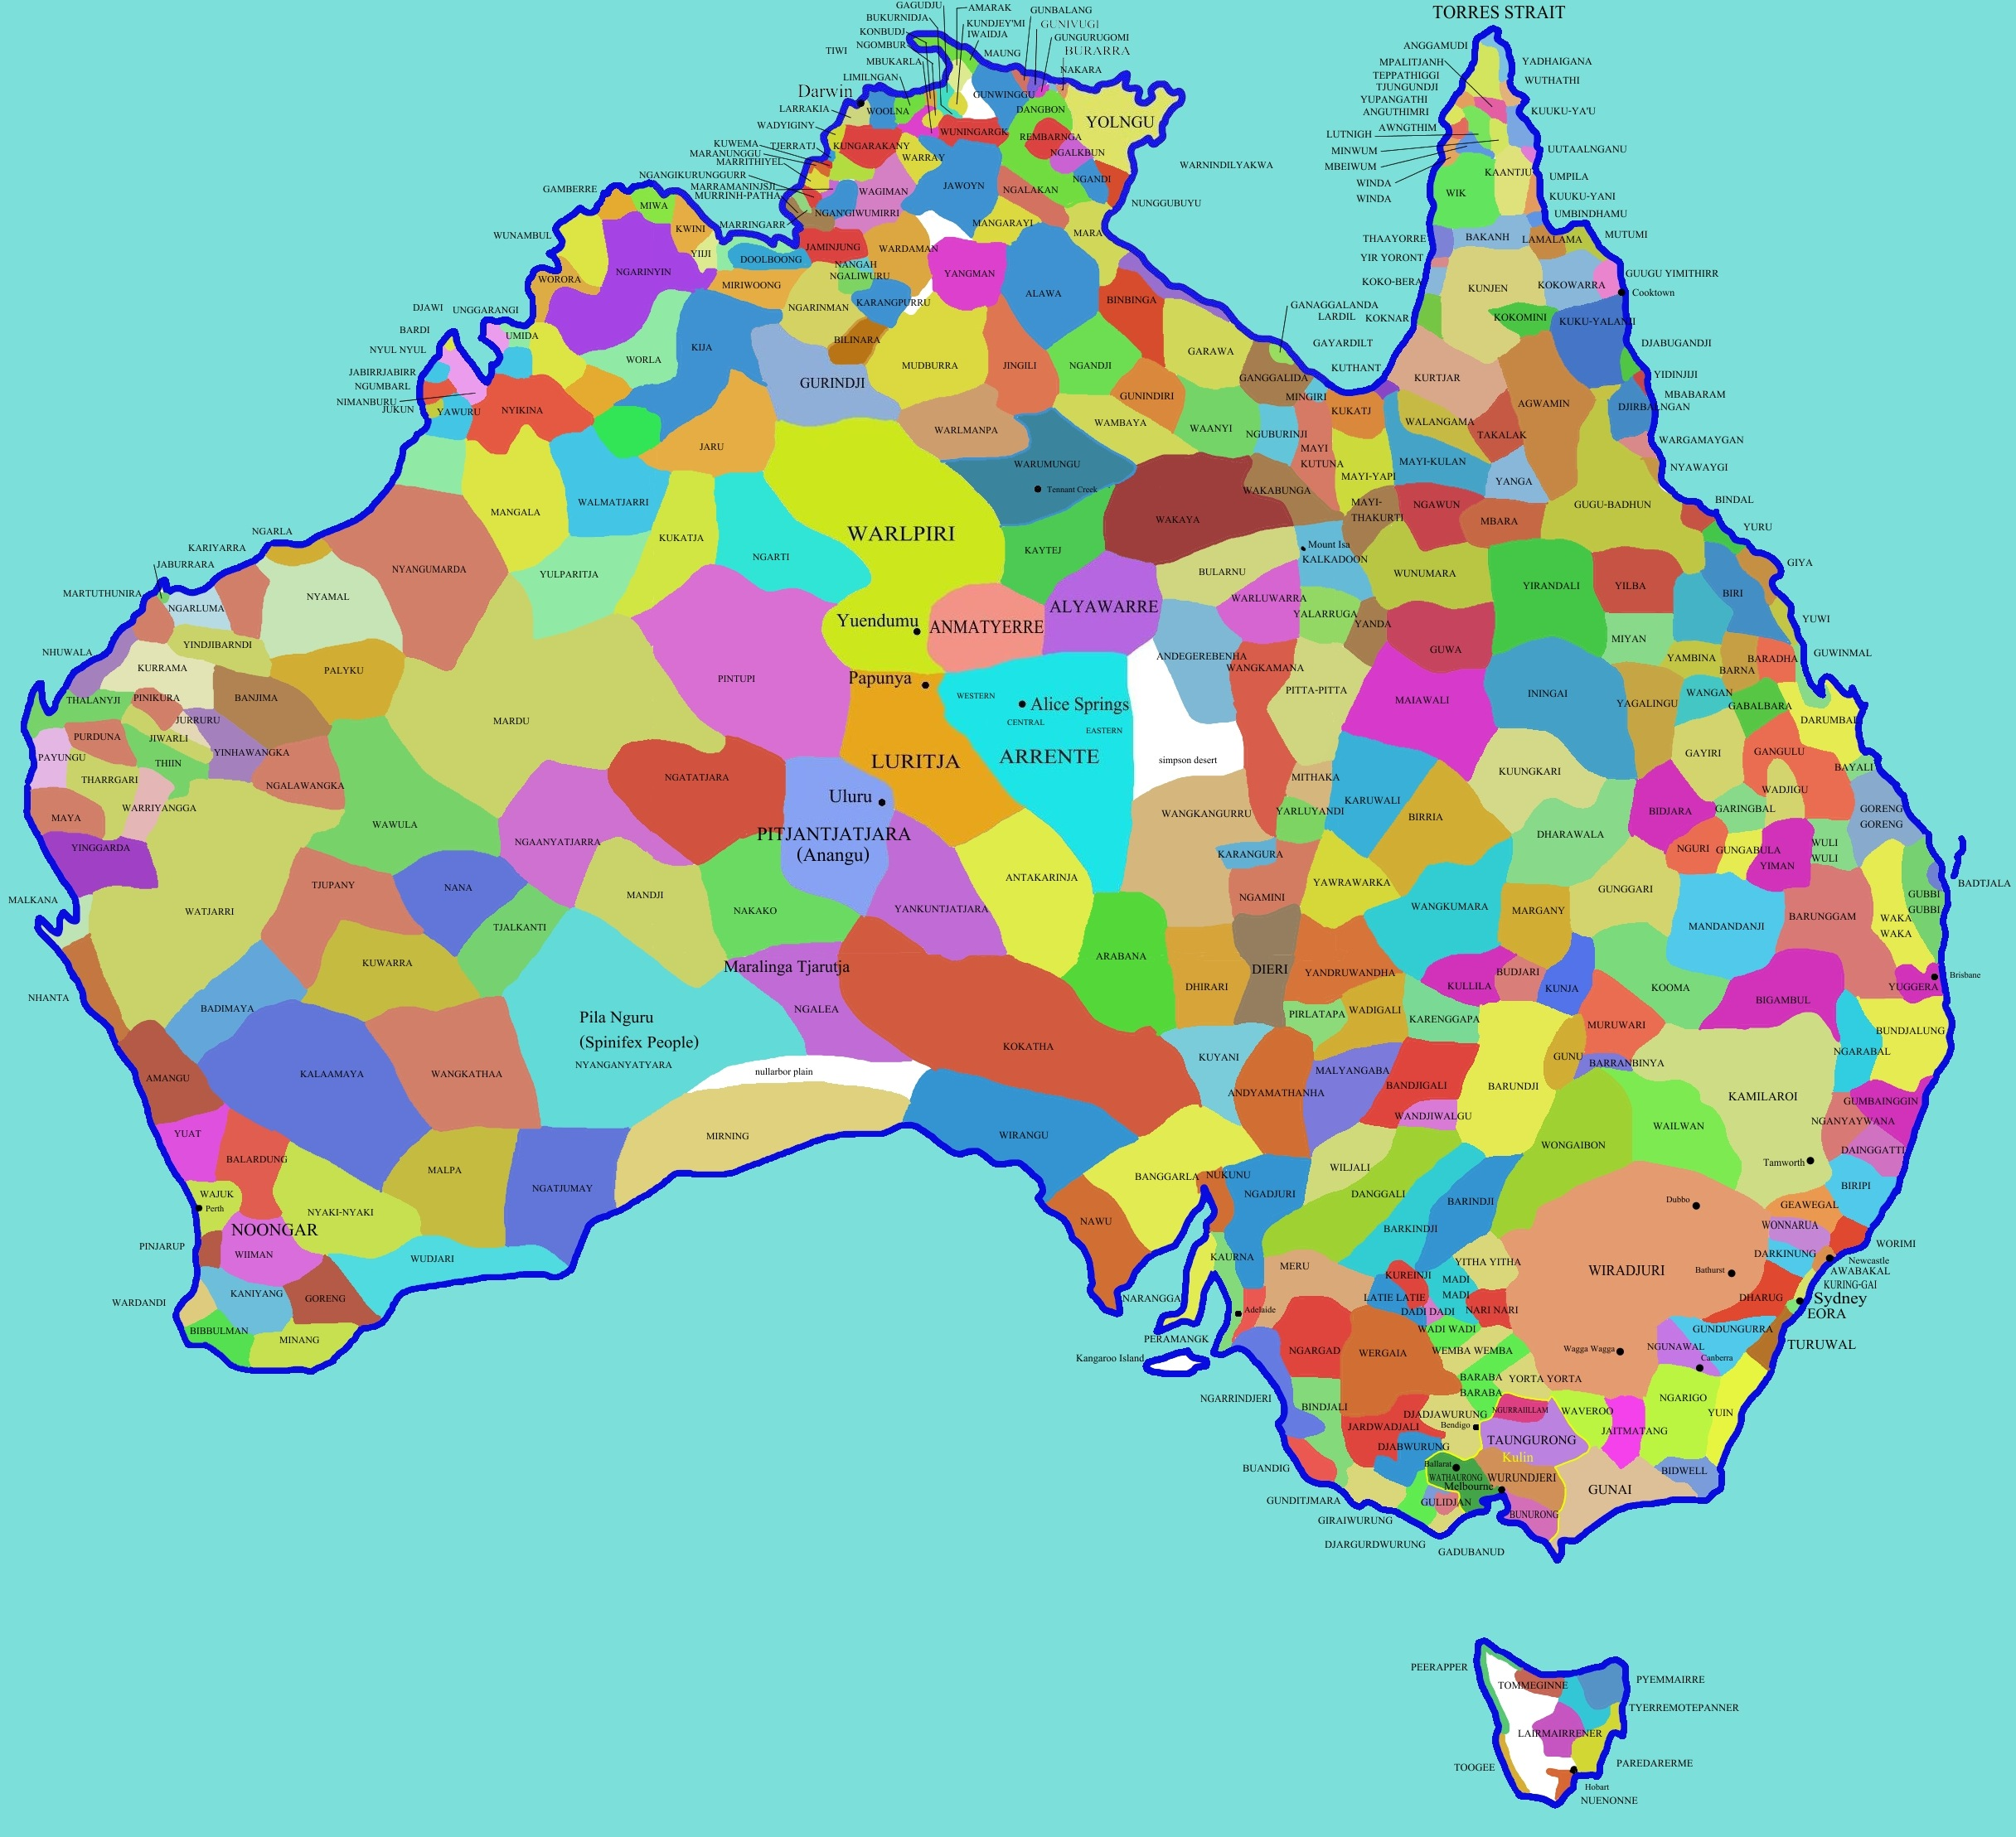
For Aboriginal people The land and the earth are ‘Mother’ and it is mother earth that creates, nurtures, shelters and sustains. All things in the natural world are bound to each other through connectedness and interdependency.
Notes:
Central to Aboriginal Law is the responsibility to sustain the cultural landscape as it is set down from the creation stories.
Traditional Aboriginals of the present, as well as all Aboriginals from the past had a special view of the natural environment around them, being familiar intimately with every part of it, this detailed knowledge being essential to carry on their way of life. According to their beliefs they shared the same life essence with all natural species and elements in the environment. The natural world was included in their social world, and they humanised their natural world, including the land as such, as viewed in the Dreaming. (The greatest estate on earth).

Slide 5

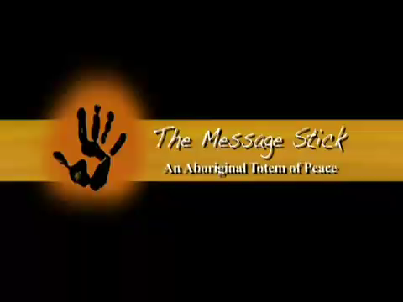
Notes:
Message stick vehicle
Reconciliation is not a destination but a WAY of being
dreamtime stories
Could you make a message stick vehicle to share your learnings?

Slide 6





The 4 Core Elements
Ecological Stewardship
Spirituality
Cultural Recognition & Awareness
Practical Reconciliation
& Justice
Notes:
Spirituality - represented by the Campfire - Learn, teach, share, understand
Cultural Recognition & Awareness - Message Stick - tell the story.
Practical Responsibilities & Justice - Journey - Walk the journey together, put learnings into practice
Ecological Stewardship - Caring for Country: looking after planet Earth.
If this was your place -
Where is your camp fire?
What message do other people see at your camp fire? Family means everything
What do you learn together and do together? How to have fun together/play games/music/football/martial arts/
Where are your sacred places?

Slide 7
`
THIS IS AN INVITATION AND A COMMITTMENT
Each FIRE Carrier commits to nourishing and educating the school community about the Aboriginal Story of the School and surrounds in order to build awareness of Aboriginal issues in the community we live in and respect the original custodians of the land.
Notes:
-The commitment is to Sandhurst Aboriginal Education and the Aboriginal Catholic Ministry to become a FIRE Carrier and in doing so:
Promote Reconciliation throughout my school community
By organizing activities to create awareness around significant dates of shared history
Incorporate Aboriginal Spirituality into our schools Catholic Identity by including the cultural and ceremonial gifts of Aboriginal people within our Catholic Identity
Adopt Opening the Doors Foundation as our partner by supporting in a practical way an annual fundraiser .Each FC also commits to nourishing and educating the school community about the Aboriginal Story of the School and surrounds in order to build awareness of Aboriginal issues in the community we live in and respect the original custodians of the land.

Slide 8

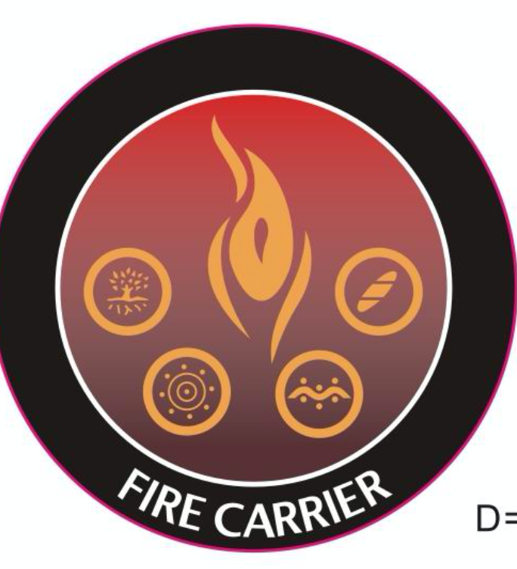
`
What does being a Fire Carrier mean?
How is it going to look at your school?
Notes:
FIRE
Friends
Igniting (arouse kindle light, instigate,provoke, spark, trigger, to set on fire)
Reconciliation (reunite, reconcile,bring back together,become friends)
Education (develop, improve, to educate, prepare, teach, instruct)
Do exercise now....

Slide 9
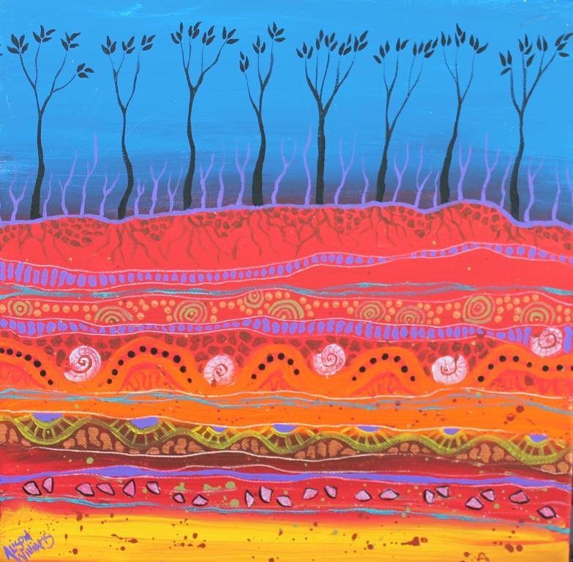
What have you heard today that you didn’t know before?
What does F.I.R.E. stand for?
What could YOU do if you became a FIRE carrier?

Slide 10
We invite you now to become FIRE carriers, to join with the story of this land and honour creation as sacred while displaying an attitude of responsibility for the Earth as ecological stewards and custodians.
Notes:
FIRE
Friends
Igniting (arouse kindle light, instigate,provoke, spark, trigger, to set on fire)
Reconciliation (reunite, reconcile,bring back together,become friends)
Education (develop, improve, to educate, prepare, teach, instruct)

Slide 11
As joint caretakers of the land today and all that has been created,
let us bless each other with the following blessing:
As you journey in the footsteps the ancient ones
May you feel their courageous spirit,
Travel gently with respect on this sacred land.
Hold the sacredness of the land, close to your heart and may the
spirits of the Ancestors, watch over and keep you safe. Amen
Notes:
FIRE
Friends
Igniting (arouse kindle light, instigate,provoke, spark, trigger, to set on fire)
Reconciliation (reunite, reconcile,bring back together,become friends)
Education (develop, improve, to educate, prepare, teach, instruct)

Slide 13
May the fire be in my thoughts
Making them good and just
May it protect me from all harm
May the fire be in my eyes
May it open my eyes to see what is good in life
May it protect me from speaking against others
May the fire be in my ears
I pray that I may hear with deep listening
So that I may hear the flow of water
And of all Creation and the Dreaming
May I be protected against gossip
And from things that break down and harm families

Slide 14
May the fire be in my arms and hands
So that I may be of service and build up love
May the fire protect me from all violence
May the fire be in my whole being
In my legs and feet
Enabling me to walk the earth with respect and care
So that I may journey in ways of goodness and trust
And be protected from walking away from what is true.
Amen

Slide 15
https://www.reconciliation.org.au/reconciliation/what-is-reconciliation/#:~:text=The%20five%20dimensions%20of%20reconciliation

Slide 16
https://fromtheheart.com.au/education/#/lessons/uWNnu6QKBe0x3w0nHedIY8hMbO4eZhmb

Slide 17
F.I.R.E Carrier
FRIENDS IGNITING RECONCILIATION
through EDUCATION
Notes:
What does FRIENDS mean to You?
How would you define IGNITING?
Explain RECONCILIATION when you think about creation/country
EDUCATION - a part of your role will be sharing the knowledge gained with the school community.
Spirituality - represented by the Campfire - Learn, teach, share, understand
Cultural Recognition & Awareness - Message Stick -
Practical Responsibilities & Justice - Journey - Walk the journey together, put learnings into practice
Ecological Stewardship - care for country

