Slide 1
Stations of the Cross
Easter 2024

Slide 2
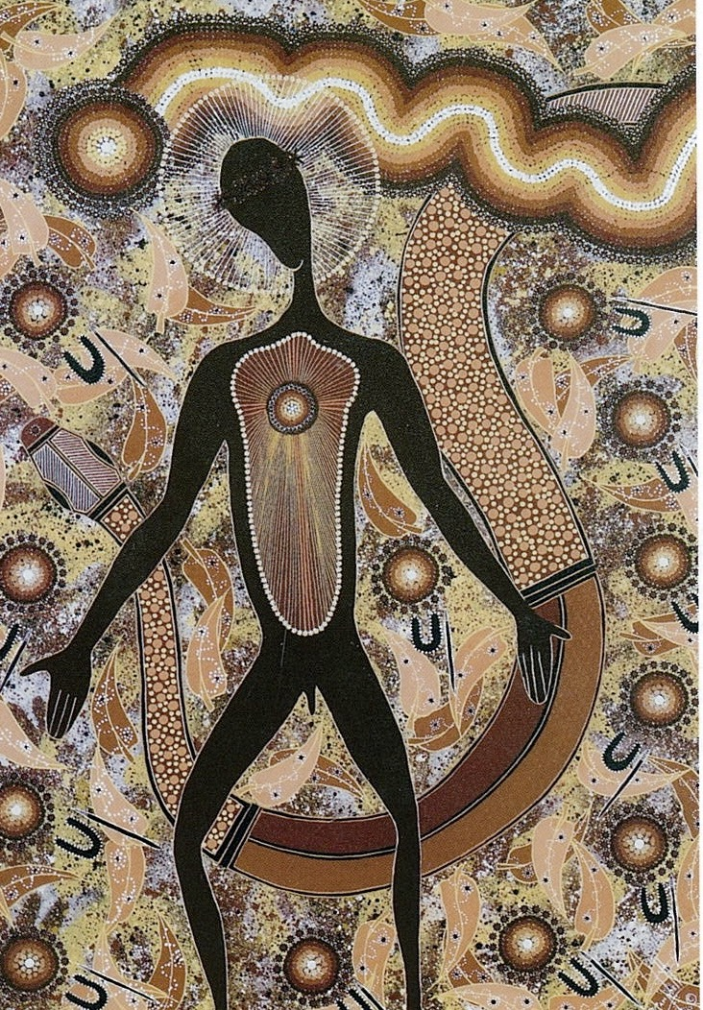
Station One
Pilate asked what is the truth.
Prayer
    God of the Dreaming,
Your presence in all time is a constant mystery,
Our need for strength in times of unjust decision-making comes from your example of constancy and fidelity.
Jesus, teach us to be open to the love of each other and the care of our environment.
      Amen
      Response:
      Lord hear my prayer, O Lord hear my prayer, When I call, answer me
      Lord hear my prayer, O Lord hear my prayer, Come and listen to me
Notes:
LOUISE- The shouted, “Crucify him!” “Why?” Pilate asked them. “What harm has he done?” But they shouted all the louder. “Crucify him!” So Pilate, anxious to Placate the crowd, released Barabbas for them and, having ordered Jesus to be scourged, handed him over to be crucified. (Mark 15: 14-15)
(Holding the cross)- Setting the scene-Nikki
The Rainbow Serpent represents the centre of the Dreaming, where the ancestors recognised the power of good over evil. God through Jesus has been a part pf the journeys and experiences of Aboriginal people and all people. The joy of life in his humanity is shown by the illuminated symbol in the centre of Jesus’ body. (Watch this symbol as we journey through the stations.) The heart of the figure represents His union with the Father.
Reflection - Michael
Pilate asked what is the truth. Then sent Jesus to His death. Do our leaders today ask what truth is? Jesus stands for all those oppressed and marginalised. He believed in the love that God is constantly giving, even in time of suffering.
Michael lead People’s Prayer- Prayer
Response- Lord hear my prayer, O Lord hear my prayer, Come and listen to me
Louise - With Jesus we continue the Way of the Cross…….

Slide 3
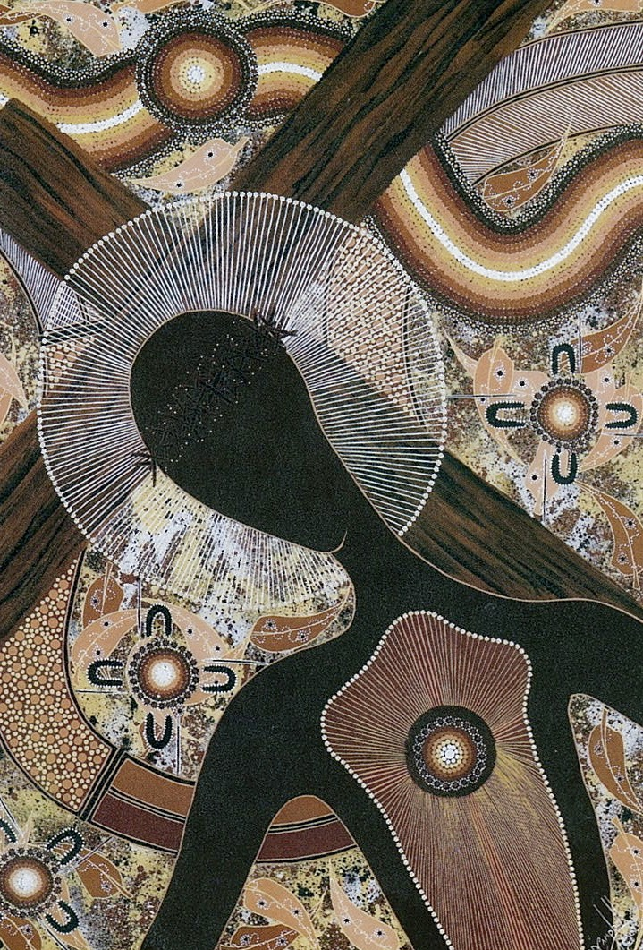
Station Two
Jesus carries the Cross.
Prayer
Suffering Jesus we understand your agony as we stand and mourn with suffering people of the world.
Many are innocent and cruelly put to death by uncaring judgements.
Give us the wisdom to be one with you.
Amen
      Response:
      Lord hear my prayer, O Lord hear my prayer, When I call, answer me
      Lord hear my prayer, O Lord hear my prayer, Come and listen to me
Notes:
LOUISE— Jesus said, “If anyone wants to be a follower of mine, let him renounce himself and take up his cross and follow me” (Luke 9: 23)
(Holding the cross)- Setting the scene- Nikki
Jesus embraces the cross in a non-judgemental stance (no facial expressions). His journeying is one of dedication to wisdom and the oneness of God and us. The cross comes from the beautiful gum tree which is a nurturing and life giving source in the land of the Southern Cross. The burnt and scarred trunk still lives on from the inner sap, a symbol of eternal life.
Reflection-Michael
What do we learn from this? The freedom with which God gifted us can be used for good or evil. Jesus remains committed to live for us all.
Michael lead in People’s Prayer- Prayer
Response- Lord hear my prayer, O Lord hear my prayer, Come and listen to me
Louise- With Jesus we continue the Way of the Cross…….

Slide 4
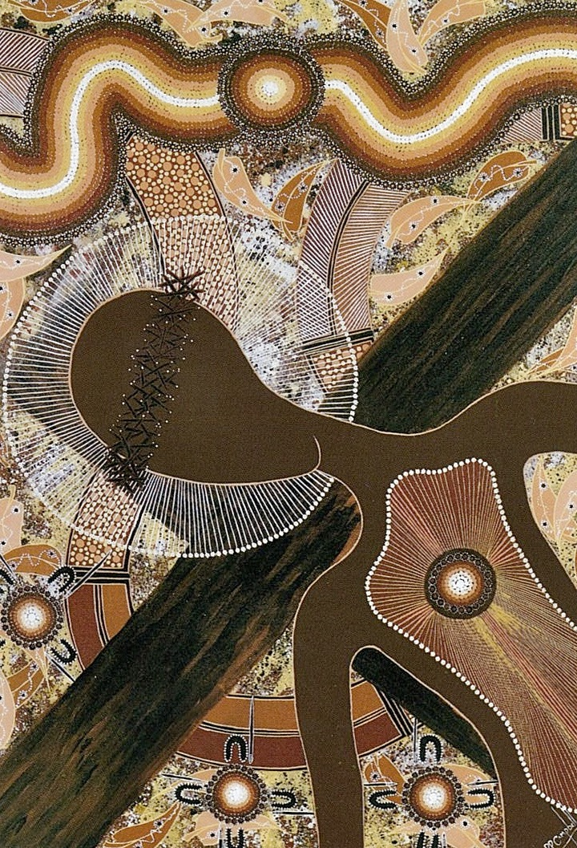
Station Three
Jesus falls the first time.
Prayer
Open our minds on the journey when it is easy and hard in our paths.
Help us to be ever present to You our Creator Spirit, especially in times of our weakness.
Give us the strength to see God in all the ones in Creation.
Amen
      Response:
      Lord hear my prayer, O Lord hear my prayer, When I call, answer me
      Lord hear my prayer, O Lord hear my prayer, Come and listen to me
Notes:
LOUISE - Jesus said, “They led him out to crucify him” (Mark 15:20) )
(Holding the cross)- Setting the scene- NIKKI
The white circular aura symbolises the Miimi Spirtits of our past Elders, revealing themselves to us to remind us of their wisdom still present (relating closely tour teaching of the communion of saints). The circular glow depicts the strength of Jesus in His Journey to overcome evil, depicted by the serpent. The white dots and leaves remind us that our Creator Spirit is present in everything.
Reflection Michael
Under great pressure Jesus falls and he knows we too will fall. He rises from the hard ground and goes on believing God will walk with Him. We will fall at times but our faith in Jesus’ love will help us to forgive others and ourselves and to keep going.
Michael lead People’s Prayer- Prayer
Response- Lord hear my prayer, O Lord hear my prayer, Come and listen to me
- With Jesus we continue the Way of the Cross…….LOUISE

Slide 5
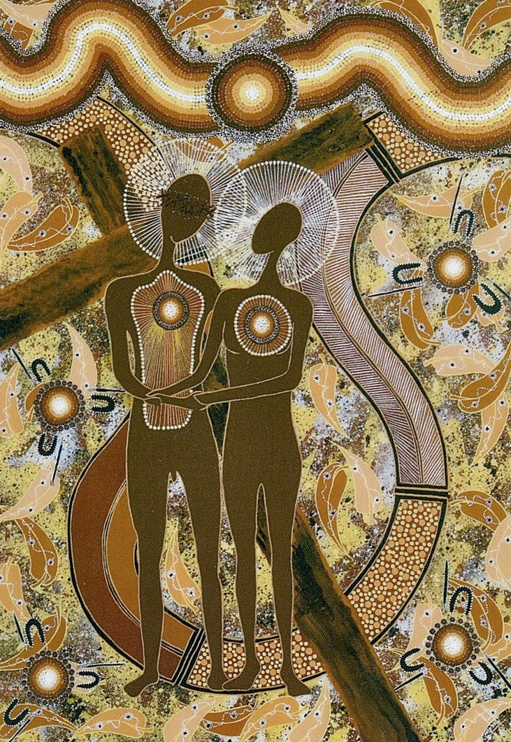
Station Four
Jesus meets his mother.
Prayer
Jesus, your heart must have been breaking as Mary gently caresses you.
You Mary, who held and led Jesus through his growth in life, is the teller of the stories of his great suffering and love
Mother walk with us, as we trust in Jesus.
Amen
      Response:
      Lord hear my prayer, O Lord hear my prayer, When I call, answer me
      Lord hear my prayer, O Lord hear my prayer, Come and listen to me
Notes:
LOUISE - Simeon said to Mary, “You see this child: he is destined for the fall and for the rising of many in Israel, destined to be a sign that is rejected- and a sword shall pierce your own soul, too.” ( Luke 2:34)
(Holding the cross)- Setting the scene-NIKKI
His head is turned to her and her head to Him. His crown of thorns, a cause of anguish to his mother, and Jesus’ helpless to touch, stands on the Serpent, and indication of the fight over evil. Mary's mouth is symbolic of Aboriginal women who are the holders and teachers of the stories. For a mother this would be heart wrenching. Seeing the pain on her eyes, He reaches out to her in silence.
Reflection - Michael
This is how God lifts us up from our distress, and it is in this silences, that we find strength of the Spirit. The journey of many young boys and their families coincides with the pain of Mary, when many were taken away from family to hostile environments.
MICHAEL lead in People’s Prayer- Prayer
Response- Lord hear my prayer, O Lord hear my prayer, Come and listen to me
- With Jesus we continue the Way of the Cross…….LOUISE

Slide 6
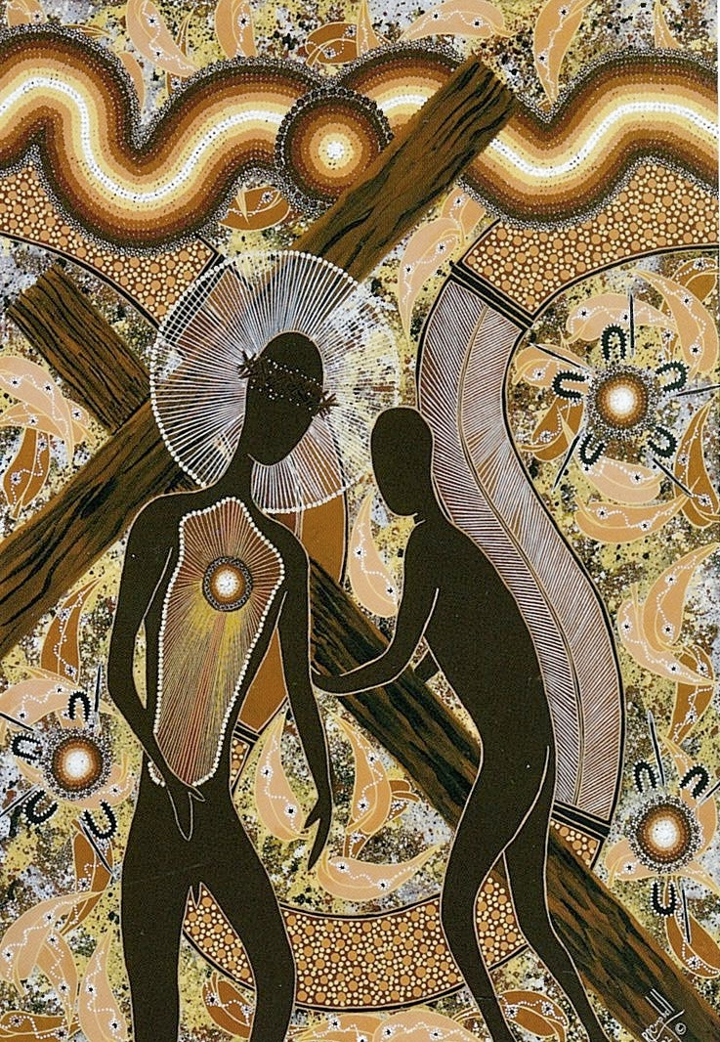
Station Five
Jesus is helped to carry the cross.
Prayer
Creator Spirit
You are all things to all people.
In your love, You include all.
God had no different.
Let us trust in Your constant love shown in this time of suffering.
Amen
      Response:
      Lord hear my prayer, O Lord hear my prayer, When I call, answer me
      Lord hear my prayer, O Lord hear my prayer, Come and listen to me
Notes:
LOUISE - They enlisted a passer by, Simon of Cyrene, who was coming in from the country, to carry his cross. (Mark 13:21)
r (Holding the cross)- Setting the scene- NIKKI
The white dots represent the presence of our Creator Spirit, God constantly coming down to us, connecting heaven and earth. Simon eager to embrace the Cross and Jesus humbly accepts his help. What a beautiful scene of reconciliation.
Reflection - MiCHAEL
Jesus is helped to carry the cross. And who isit? A black man from the crown, Simon. He is glad to help. Are we able to learn from Simon?
MICHAEL lead People’s Prayer- Prayer
Response- Lord hear my prayer, O Lord hear my prayer, Come and listen to me
- With Jesus we continue the Way of the Cross…….LOUISE

Slide 7
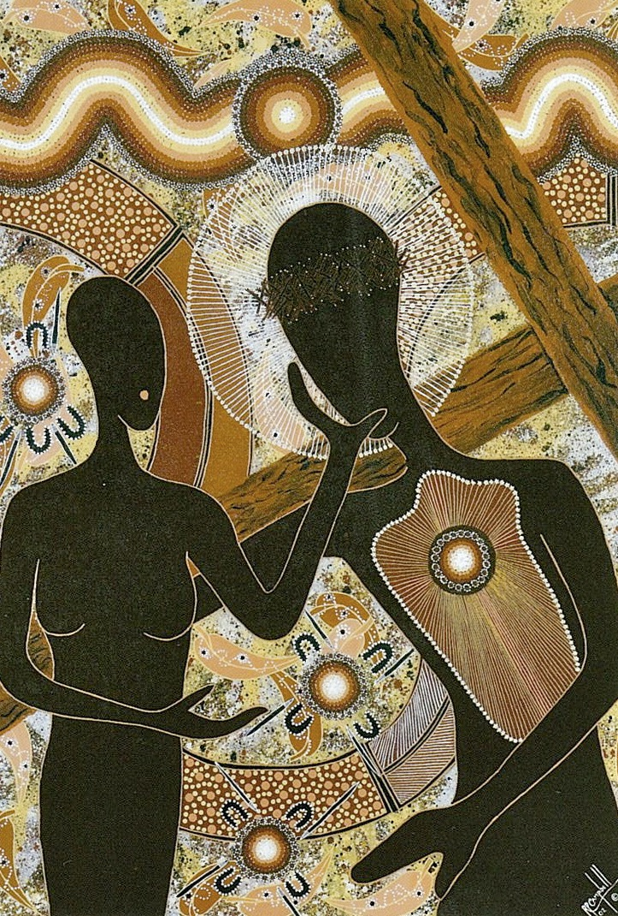
Station Six
All the faithful women meet Jesus.
Prayer
Jesus, in your banishment, teach us to reach out as Veronica did,to the lonely, oppressed and different.
Let us trust in Your constant love shown in this time of suffering.
Amen
      Response:
      Lord hear my prayer, O Lord hear my prayer, When I call, answer me
      Lord hear my prayer, O Lord hear my prayer, Come and listen to me
Notes:
LOUISE- Happy the merciful: they shall have mercy shown on them. (Matthew 5:7)
(Holding the cross)- Setting the scene- NIKKI
The figures in this picture have no expression, symbolising that there is no doubt or judgement. Veronica portrays the presence of compassionate aunties, who gave of their wisdom and knowledge to nurture the development of the young. Jesus, in His need, is revealing His love to her as she wipes His face.
Reflection - MICHAEL
Veronica wants to help Jesus in his pain and wipes His face, which is covered in blood and sweat. We learn to reach out to the Jesus in our brothers and sisters who are lonely, hurt or ill.
MICHAEL lead People’s Prayer- Prayer
Response- Lord hear my prayer, O Lord hear my prayer, Come and listen to me
- With Jesus we continue the Way of the Cross…….LOUISE

Slide 8
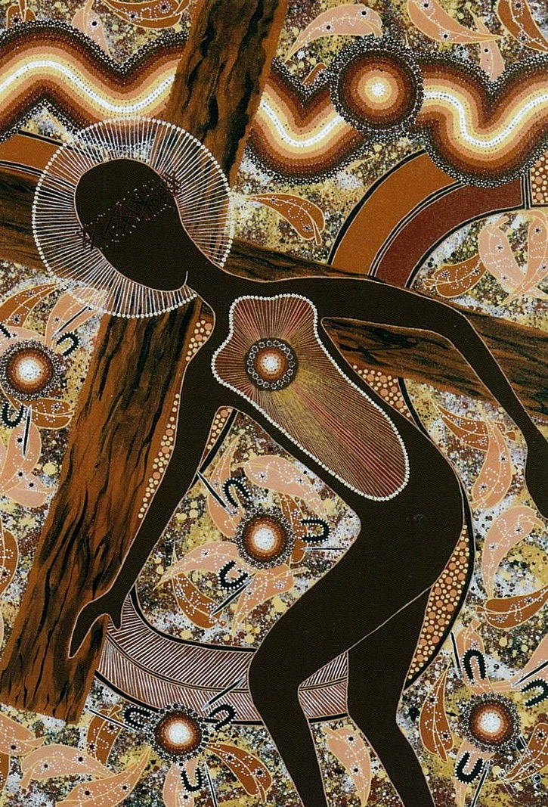
Station Seven
Jesus has fallen again
Prayer
Jesus, as you fell on the rough ground we think of insults and damage of racism that is hurled at the marginalised.
We pray for the trust in the faithfulness of God and His ever present forgiveness.
Amen
      Response:
      Lord hear my prayer, O Lord hear my prayer, When I call, answer me
      Lord hear my prayer, O Lord hear my prayer, Come and listen to me
Notes:
LOUISE- Jesus turned and said to Peter, “Get behind me Satan! You are an obstacle in my path, because the way you think is not God’s way but man’s.” (Matthew 16: 23)
(Holding the cross)- Setting the scene- NIKKI
Jesus embraces the cross, He symbolises the nurturing of God’s love within Him, which continues to burn in the heart of Jesus.
Reflection MICHAEL
Weakness is so painful. Yet Jesus struggles to get up from the hard rough ground. The lesson He is teaching us is to keep on trusting in God’s faithfulness when we fall.
MICHAEL lead People’s Prayer- Prayer
Response- Lord hear my prayer, O Lord hear my prayer, Come and listen to me
- With Jesus we continue the Way of the Cross…….LOUISE

Slide 9
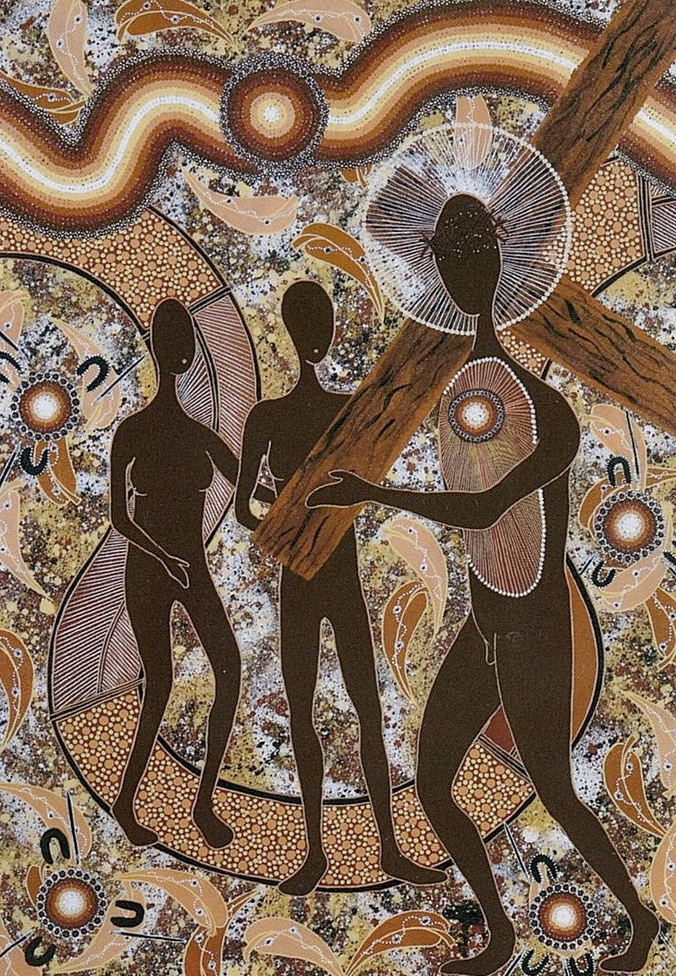
Station Eight
More women are weeping and sobbing for Jesus in His suffering.
Prayer
Jesus, you welcomed the women in their sorrow and encouraged them to look after themselves and their families.
Help us to cherish the gifts that surround us, to share your blessings with our sisters and brothers and to experience the joy of the Dreaming.
We ask this through the Creator Spirit.
Amen
      Response:
      Lord hear my prayer, O Lord hear my prayer, When I call, answer me
      Lord hear my prayer, O Lord hear my prayer, Come and listen to me
Notes:
LOUISE- Large numbers of people followed him and of women too, who mourned and lamented for him. But Jesus turned to them and said, “Do not weep for me: weep rather for yourselves and for your children.” (Luke 23: 27-28)
(Holding the cross)- Setting the scene- NIKKI
There are spears around the fire which is symbolic of the male communal gathering. The women meet their sons as they return from initiation and give them encouragement when dancing their Dreaming stories. Here the women meeting Jesus empower Him in love.
Reflection MICHAEL
Jesus stops to speak to the women. Even at this time Jesus is thinking of others.
MICHAEL lead People’s Prayer- Prayer
Response- Lord hear my prayer, O Lord hear my prayer, Come and listen to me
- With Jesus we continue the Way of the Cross…….LOUISE

Slide 10
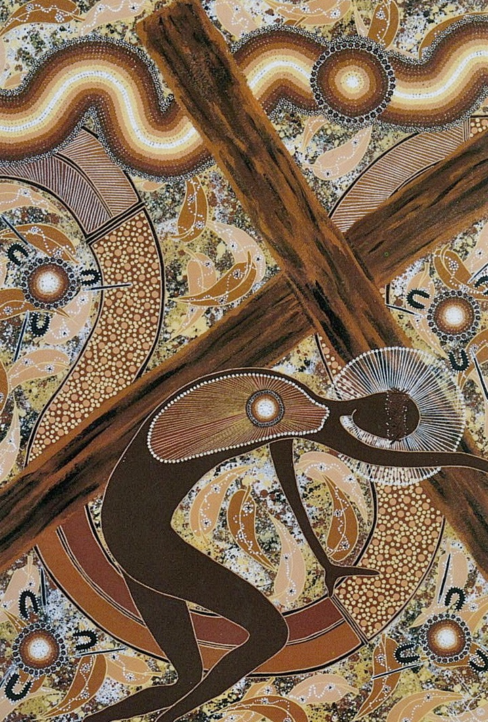
Station Nine
The cross so heavy falls on Him again
Prayer
The journey is long for you Jesus, as it has been for the artist of this expression of Your Initiation.
As followers of your life story, we cannot avoid the pain, so we ask for faith in God to trust in the constant love, though hidden, is always with us.
Amen
      Response:
      Lord hear my prayer, O Lord hear my prayer, When I call, answer me
      Lord hear my prayer, O Lord hear my prayer, Come and listen to me
Notes:
LOUISE- Anyone who wants to save his life will lose it; but anyone who loses his life for my sake, that one will save it. (Luke 9:24)
(Holding the cross)- Setting the scene- NIKKI
The symbol of the rainbow serpent becomes a very dominant aspect in this image, because the artist has travelled a rugged journey but still depicts great hope and trust. The central part of the figure still glows in hope and trust.
Reflection - MICHAEL
Jesus cries in pain! With love you have for us Jesus, to go to such lengths to prove it.
MICHAEL lead People’s Prayer- Prayer
Response- Lord hear my prayer, O Lord hear my prayer, Come and listen to me
- With Jesus we continue the Way of the Cross…….LOUISE

Slide 11
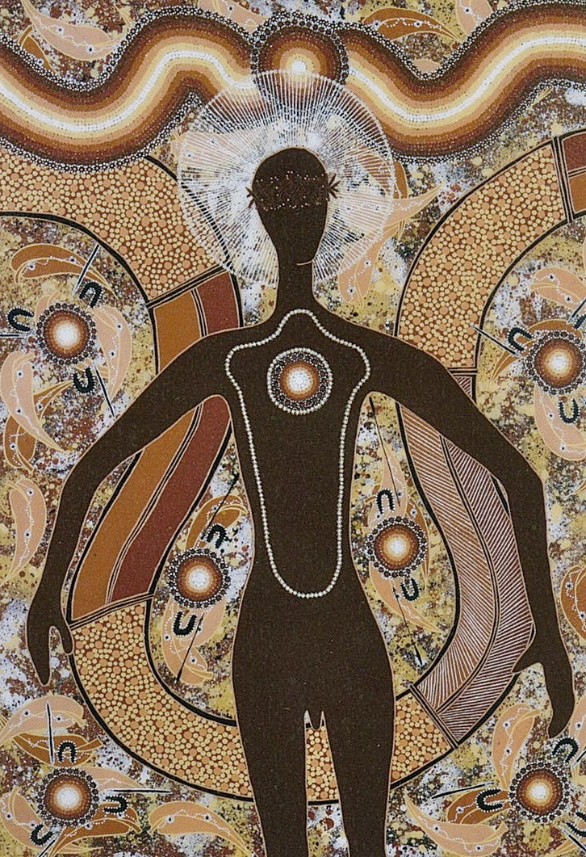
Station Ten
More Humiliation........ for our gentle Saviour.
Prayer
Creator Spirit, Fill us with the gift of Your trust, to enable us to use our worldly goods, to grow in Your life, so that the others will know that you love us.
As the symbol for the rainbow serpent is strength, fill us with this gift to enable us to bring about reconciliation between new and old.
Amen
      Response:
      Lord hear my prayer, O Lord hear my prayer, When I call, answer me
      Lord hear my prayer, O Lord hear my prayer, Come and listen to me
Notes:
LOUISE- Jesus said: “Father forgive them, they know not what they are doing.” (Luke 23:34)
(Holding the cross)- Setting the scene- NIKKI
The image has lost the inner illumination, which reminds that the Saviour gave all for us, and reaches to our symbol- the rainbow serpent, for strength and reconciliation between old and new.
Reflection MICHAEL
More humiliation for our gentle Saviour. Stripped of all garments, and then His very life. This is a lesson for all of us about being detached from power, wordiness and our need for trusting God.
MICHAEL lead People’s Prayer- Prayer
Response- Lord hear my prayer, O Lord hear my prayer, Come and listen to me
- With Jesus we continue the Way of the Cross…….LOUISE

Slide 12
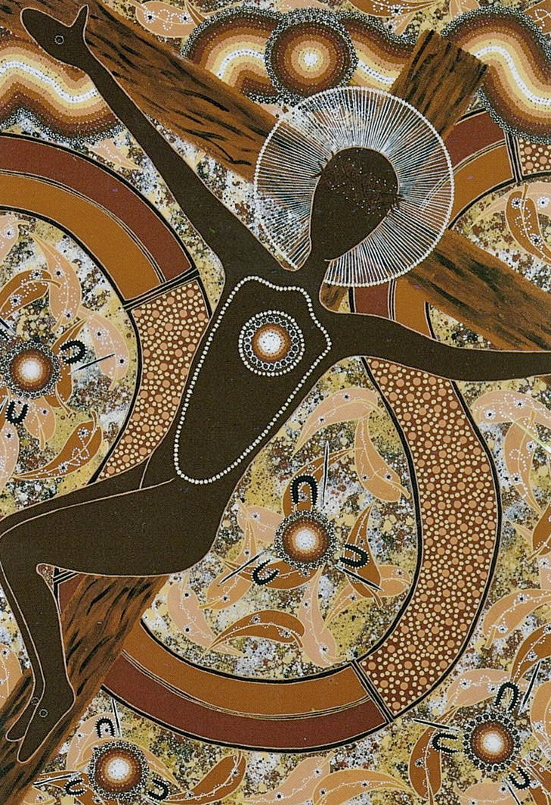
Station Eleven
Jesus is nailed to the cross.
Prayer
Spirit of the Dreaming, enlighten our hearts and minds with the total commitment by Jesus to the whole of creation expressed in the agony and ecstasy of our Rainbow Serpent.
Help us to learn from Your total dedication to use our stories for growth and our delicate environment for our enjoyment and health, which we believe the Spirit Dreaming has shown us to be right.
Amen
      Response:
      Lord hear my prayer, O Lord hear my prayer, When I call, answer me
      Lord hear my prayer, O Lord hear my prayer, Come and listen to me
Notes:
LOUISE- When they reached the place called The Skull, they crucified him and the two criminals also, one on the right, the other on the left.
(Luke 23:33)
(Holding the cross)- Setting the scene- NIKKI
The Rainbow Serpent’s colours, tell of the agony and ecstasy of good and evil. We see the symbols of the gathered people, which show the men in the background depicted by the spears at the foot of the cross. Jesus is moulded with the suffering cross made from the gum tree- living and dying in union with all creation.
Reflection MICHAEL
Good and evil are simultaneous. Change, grief and loss are part of life and challenge us to find hope in what can appear hopeless.
MICHAEL lead People’s Prayer- Prayer
Response- Lord hear my prayer, O Lord hear my prayer, Come and listen to me
- With Jesus we continue the Way of the Cross…….LOUISE

Slide 13
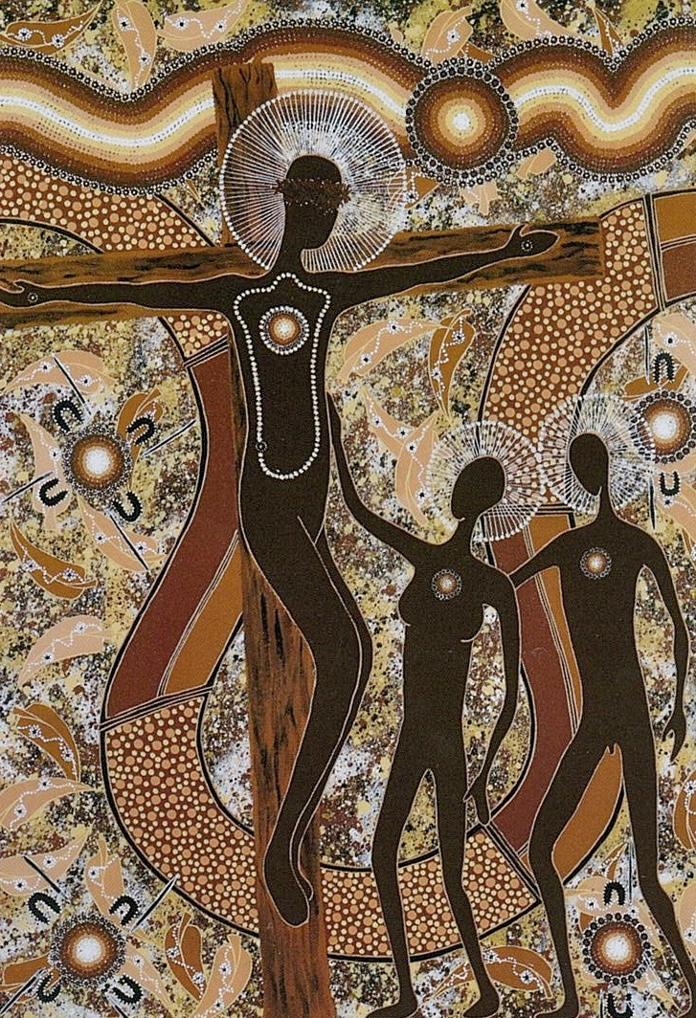
Station Twelve
Jesus speaks, “women behold you son, son behold your mother”.
Prayer
Jesus, as you human Dreaming story ends, Your care for us is shown in Your generosity as You give Your loving mother to us through John at the foot of the cross.
We ask to draw strength from this message to enable us to share our lives and gifts with others.
Amen
      Response:
      Lord hear my prayer, O Lord hear my prayer, When I call, answer me
      Lord hear my prayer, O Lord hear my prayer, Come and listen to me
Notes:
LOUISE-When Jesus saw his mother and the disciple standing beside her, he said to his mother, “Woman, here is your son.” Then he said to the disciple, “Here is your mother.” And from that hour the disciple took her into his home. (John 19: 26-27)
(Holding the cross)- Setting the scene- NIKKI
The picture depicts the culture of touching, weeping, seeing and hearing. We see the image of Mary touching her son and John supporting her. The leaf symbol with the white images is the journey to the sacred fires of the kingdom, which our culture believes is the way for all. The symbol of the white dots is the elder passing on the stories of the culture.
Reflection MICHAEL
Everyday we are faced with our own difficult choices- to seek the truth or the easy way out, to forgive or hold a grudge, to be honest with ourselves or blame someone else. Scripture says, “Choose life that you may live.” (Duet 30:19)
MICHAEL lead People’s Prayer- Prayer
Response- Lord hear my prayer, O Lord hear my prayer, Come and listen to me
- With Jesus we continue the Way of the Cross…….LOUISE

Slide 14
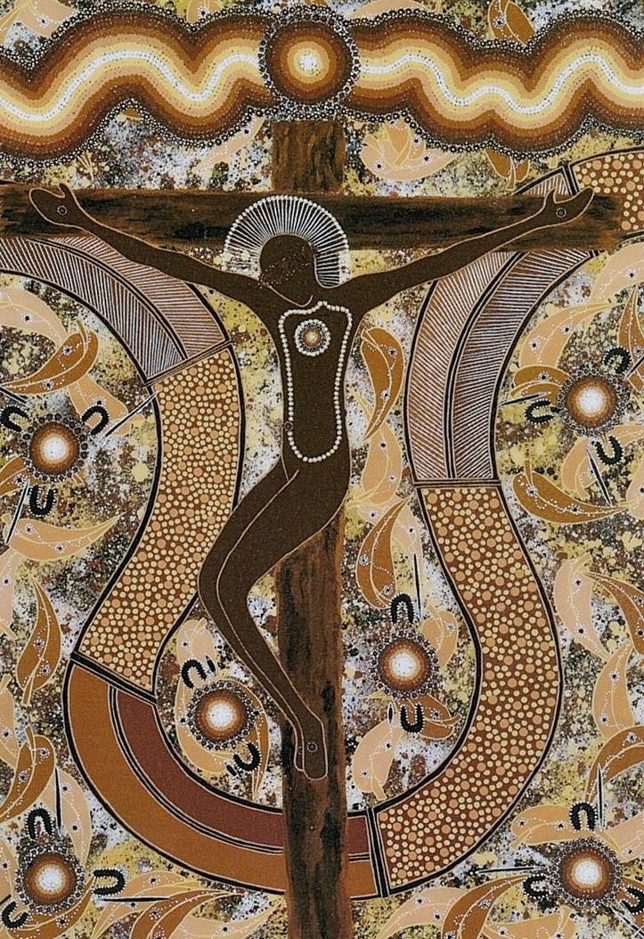
Station Thirteen
The ultimate gesture of love.
Prayer
Jesus of the constant Dreaming, Your ultimate gesture reveals to us the oneness of LOVE.
Your giving is the Spirit receiving the Spirit, showing our need to be aware of our oneness in God
Amen
      Response:
      Lord hear my prayer, O Lord hear my prayer, When I call, answer me
      Lord hear my prayer, O Lord hear my prayer, Come and listen to me
Notes:
LOUISE-Jesus gave a loud cry and breathed his last… The centurion, who was standing in front of him, had seen how he died and he said, “In truth this man was a son of God.” (Mark 15: 37-39)
(Holding the cross)- Setting the scene- NIKKI
The symbol of the dancing leaves is the cry of creation and the Spirit receives the gift of love. This same Spirit moved our elders in their constant lifestyle in this magnificent often changing homeland. Beneath the cross is the symbol of gathering, both men and women, depicted by the spears and coolamon around the fire.
Reflection MICHAEL
To die because He loved the Father and the “poor”- all in need of God.
MICHAEL lead People’s Prayer- Prayer
Response- Lord hear my prayer, O Lord hear my prayer, Come and listen to me
- With Jesus we continue the Way of the Cross…….LOUISE

Slide 15
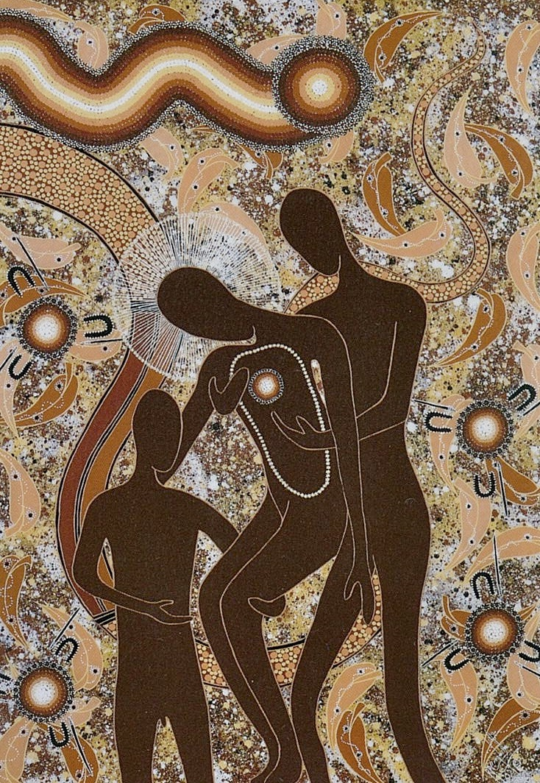
Station Fourteen
Mary His Mother receives the body of her Son in her arms from John.
Prayer
Death where is your victory?
Death where is your sting?
We pray to recognise the strength of Mary and follow her example of trust in such times of sorrow believing and hoping in the Good News that Jesus taught the Kingdom is here.
Amen
      Response:
      Lord hear my prayer, O Lord hear my prayer, When I call, answer me
      Lord hear my prayer, O Lord hear my prayer, Come and listen to me
Notes:
LOUISE - They took the body of Jesus wrapped it with the spices in linen cloths, according to the burial custom of the Jews. Now there was a garden in the place where he was crucified, and in the garden there was a new tomb in which no one had ever been laid. And so, because it was the Jewish day of Preparation, and the tomb was nearby, they laid Jesus there. (John 19: 40-42)
(Holding the cross)- Setting the scene- NIKKI
The leaves represent the environment and growth, and that our Creator sin everything. The leaves are brown however, from death; there is a renewal of life. The handprints in the background express the eternal message of God in the constant presence.
Reflection MICHAEL
All she is able to do is hold Him in death and trust in God. The tomb is a temporary resting place of silence where His mother and disciples place Jesus’ body- waiting to rise again. The spirit of Jesus grows in us as we see the pain of war and destruction. Where is his spirit? Do you call upon Him?
MICHAEL lead People’s Prayer- Prayer
Response- Lord hear my prayer, O Lord hear my prayer, Come and listen to me
- With Jesus we continue the Way of the Cross…….LOUISE

Slide 16


