Slide 1
Sorry Day Prayer Service Reflection
Notes:
This PowerPoint accompanies the ‘Sorry Day Reflection Day’ Prayer Service PDF and is intended for use in schools.
Information about the people in the photographs can be found in the ‘Notes’ section of the slides.

Slide 2
Pledge to work for reconciliation
Today I will treat everyone equally and fairly.
Today I will respect the rights of others.
Today I will be sensitive & thoughtful to those around me.

Slide 3
Today I will see people, not skin colour, race or clothes labels.
Today I will accept that everybody is unique and special.
Today I will talk to someone I don’t usually talk to.

Slide 4
Today I won’t shut out someone because they don’t fit with my group.
Today I won’t laugh at racist jokes.
Today I won’t make fun of someone who cannot speak English.
Today I won’t be condescending & patronising towards others.

Slide 5
Today I won’t judge someone on how they look.
Today I won’t start a sentence with “I’m not racist but . . . “
Today I will speak out against racism, discrimination & injustice.

Slide 6
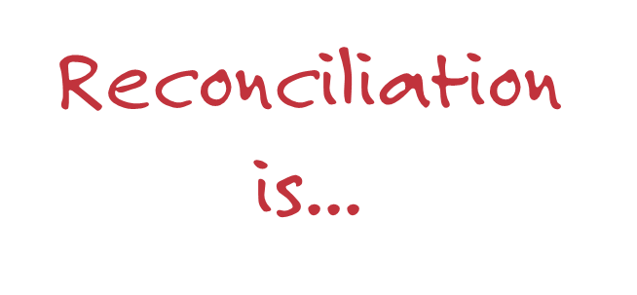

Slide 7
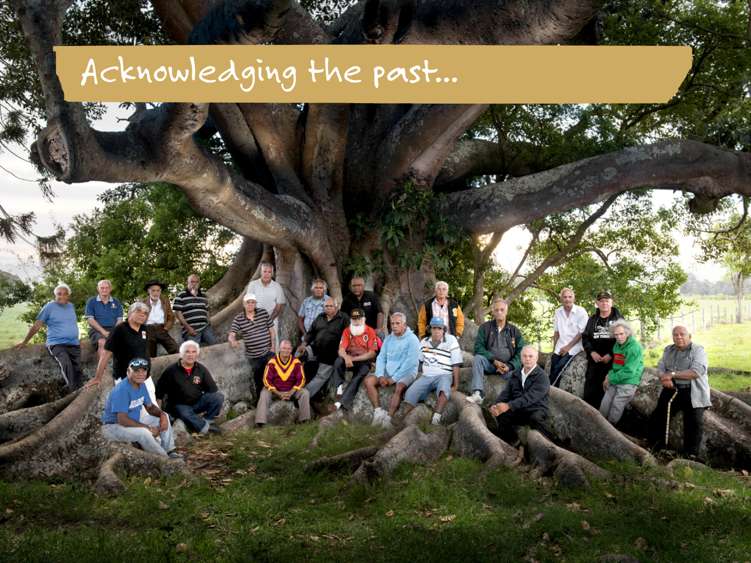
Photo credit: Peter Solness
Notes:
Kinchela Boys Home (KBH) Survivors at the tree, near the site of Kinchela Boys Home in Kempsey.
http://www.caritas.org.au/projectcompassion/weekly-stories/week-3-uncle-Richard

Slide 8
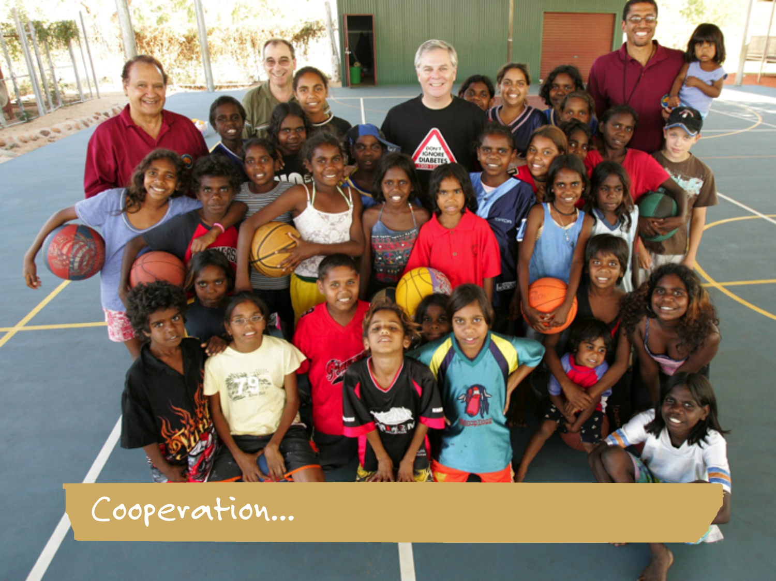
Photo Credit: Caritas Australia
Notes:
UFPA diabetes program.
THE for Unity of First People of Australia (UFPA) diabetes program is changing lives in the Kimberely with the support of Caritas Australia.

Slide 9
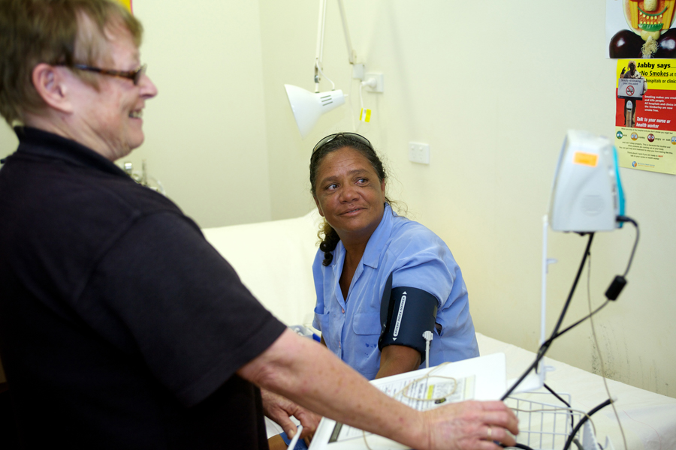

Photo Credit: Caritas Australia
Notes:
Audrey promotes good health for her community and herself.
As a scout leader and member of the Djarindjin Community Council, Audrey is a valuable advocate for Unity of First People of Australia’s (UPFA) health and wellness program: “Perhaps the greatest satisfaction I’ve felt is knowing how good my own results were by going to the clinic and checking my sugar levels.”

Slide 10
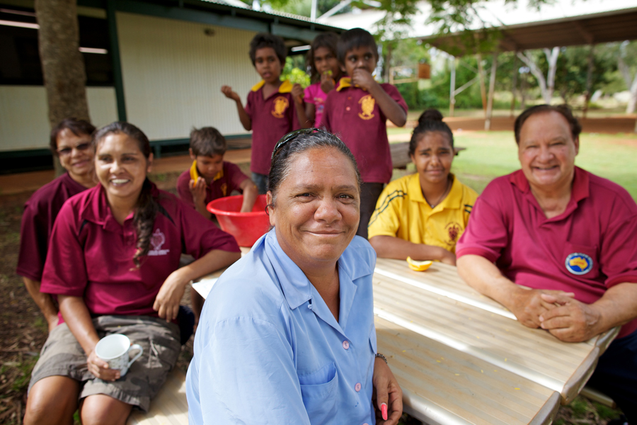

Photo Credit: Caritas Australia
Notes:
Audrey and the UFPA team.
Audrey is a Bardi woman from Djarindjin, a remote community 200km north of Broome in Western Australia. In partnership with local Aboriginal communities, the Unity of First People of Australia (UFPA) trains volunteer carers, like Audrey, who help their communities deal with and prevent ‘lifestyle’ diseases like diabetes.

Slide 11
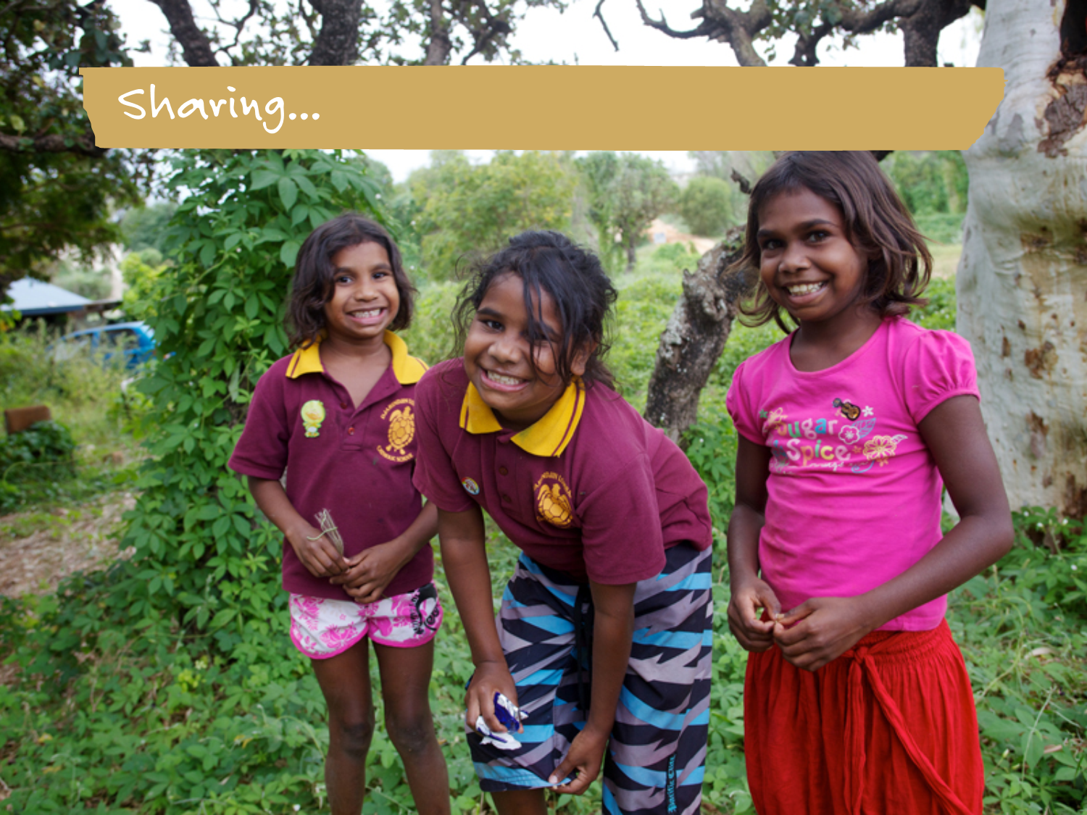
Photo Credit: Caritas Australia
Notes:
Girls in the Diabetes Management and Care program.
Caritas Australia works in partnership with the Unity of First People of Australia (UFPA) to run a holistic, community-owned Diabetes Management and Care Program in Djarindjin and eight other remote communities across the Kimberley region. With an emphasis on the dignity of wellness, the program strives to prevent diseases like diabetes and to improve healthcare across these vulnerable communities.

Slide 12
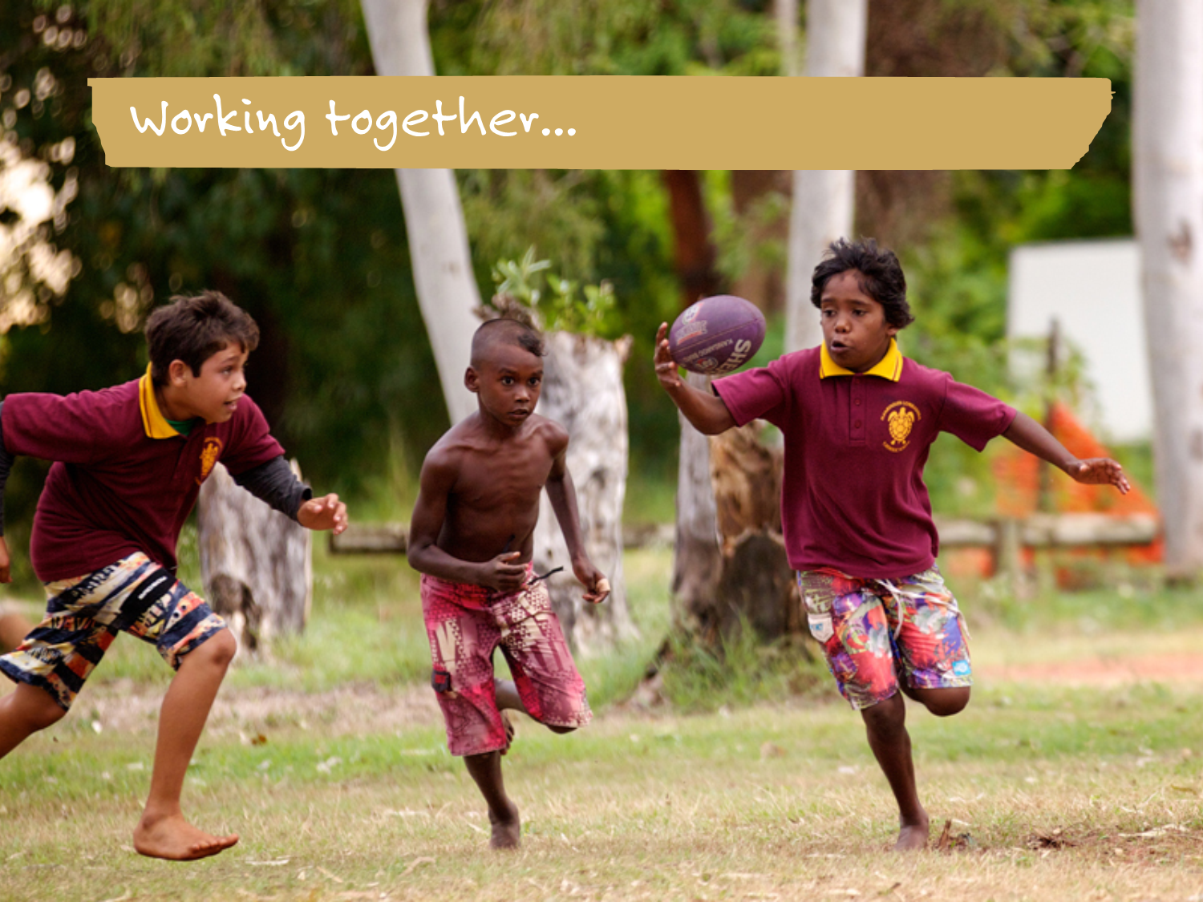
Photo Credit: Caritas Australia
Notes:
Kids enjoy a game of footy.
All nine communities supported by Caritas Australia and Unity of First People of Australia (UPFA) have seen sustained behaviour changes, including edible community gardens, community cooking classes, school breakfast programs managed by teachers and parents, and diabetes and nutrition education programs. Increasingly, the community stores are stocking healthy food choices and communities are embracing new leisure and sports initiatives.

Slide 13
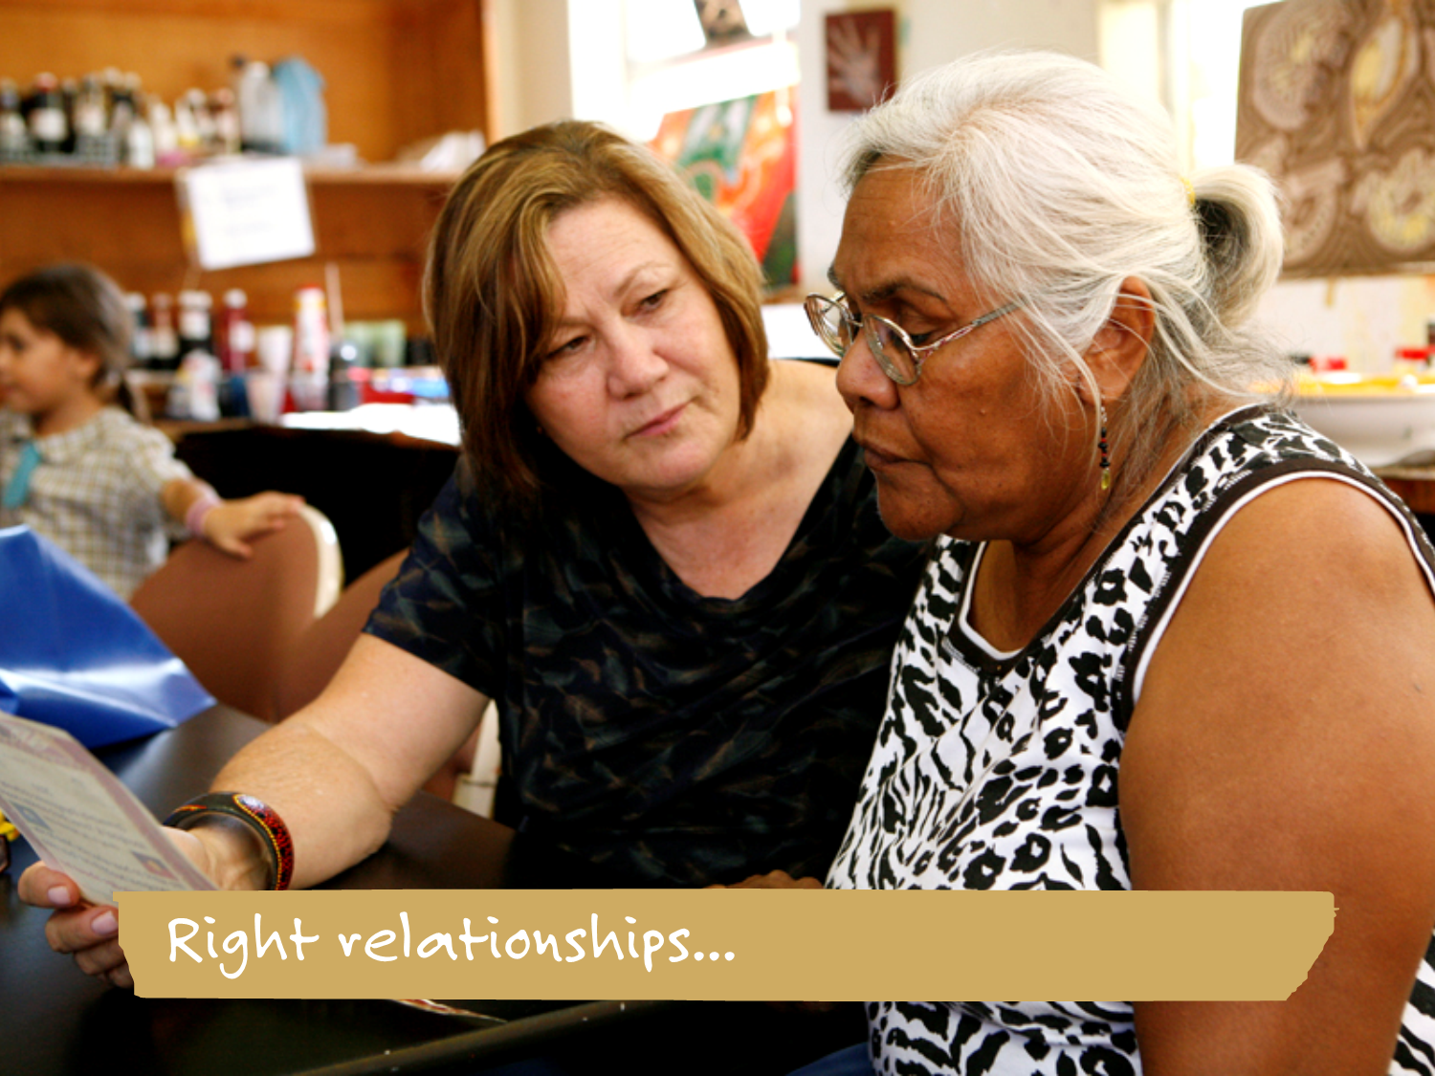
Photo Credit: Caritas Australia
Notes:
Promoting Employment Opportunities.
Administration training and finance skills are provided to Indigenous Australian women to promote sustainable livelihoods and improve employment opportunities.

Slide 14
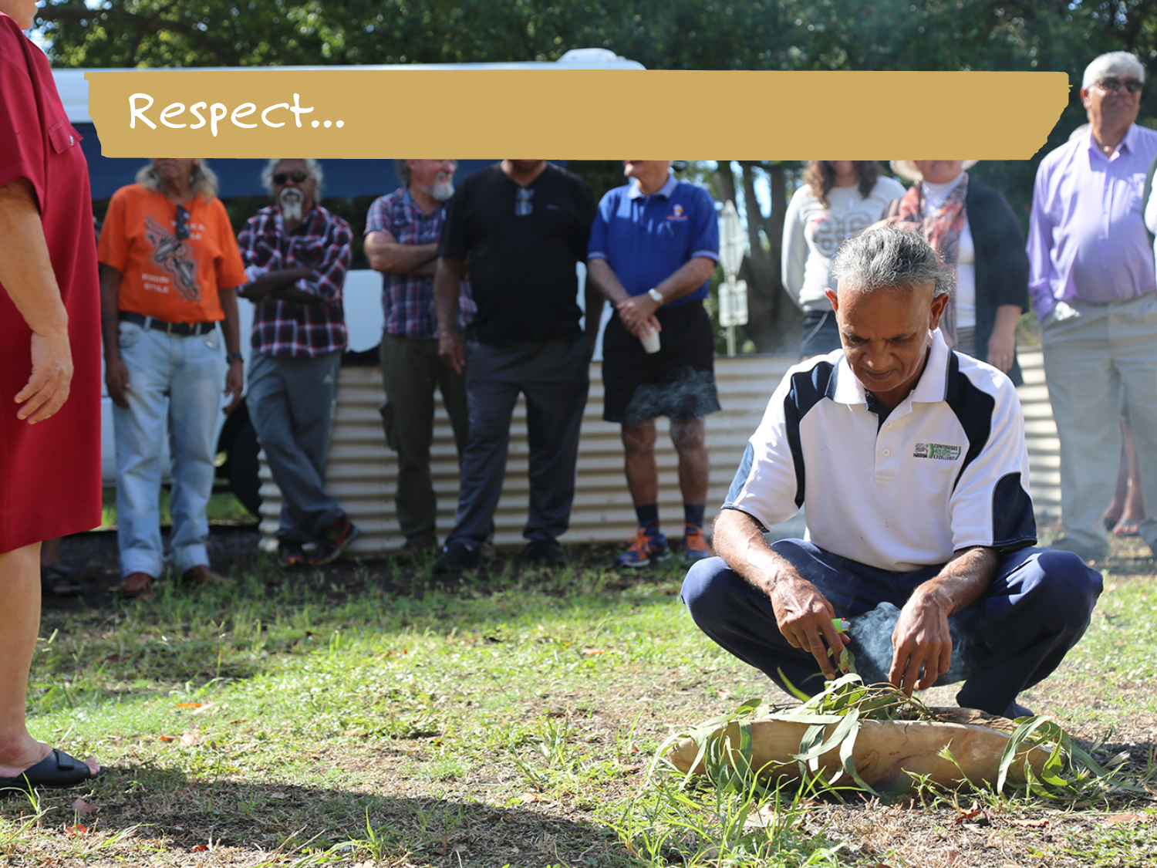
Photo Credit: Nicole Clements
Notes:
Traditonal smoking ceremony.
Traditional smoking ceremony performed at a Kinchela Boys Home Aboriginal Corporation (KBHAC) gathering of KBH survivors and their families in Kempsey, NSW.

Slide 15
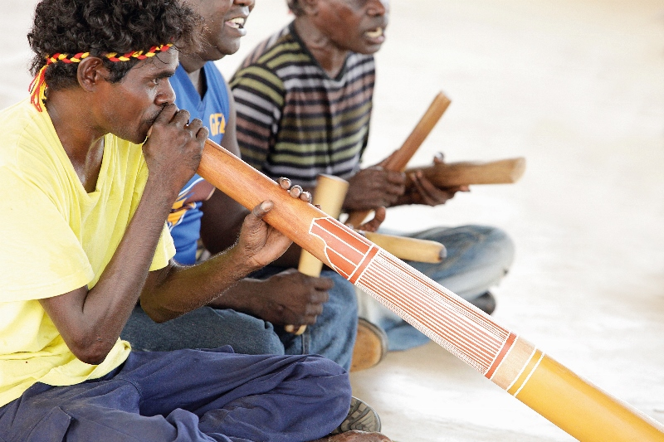
Learning about Indigenous culture and history...
Photo Credit: Danielle Lyonn
Notes:
Members of the local community playing music

Slide 16
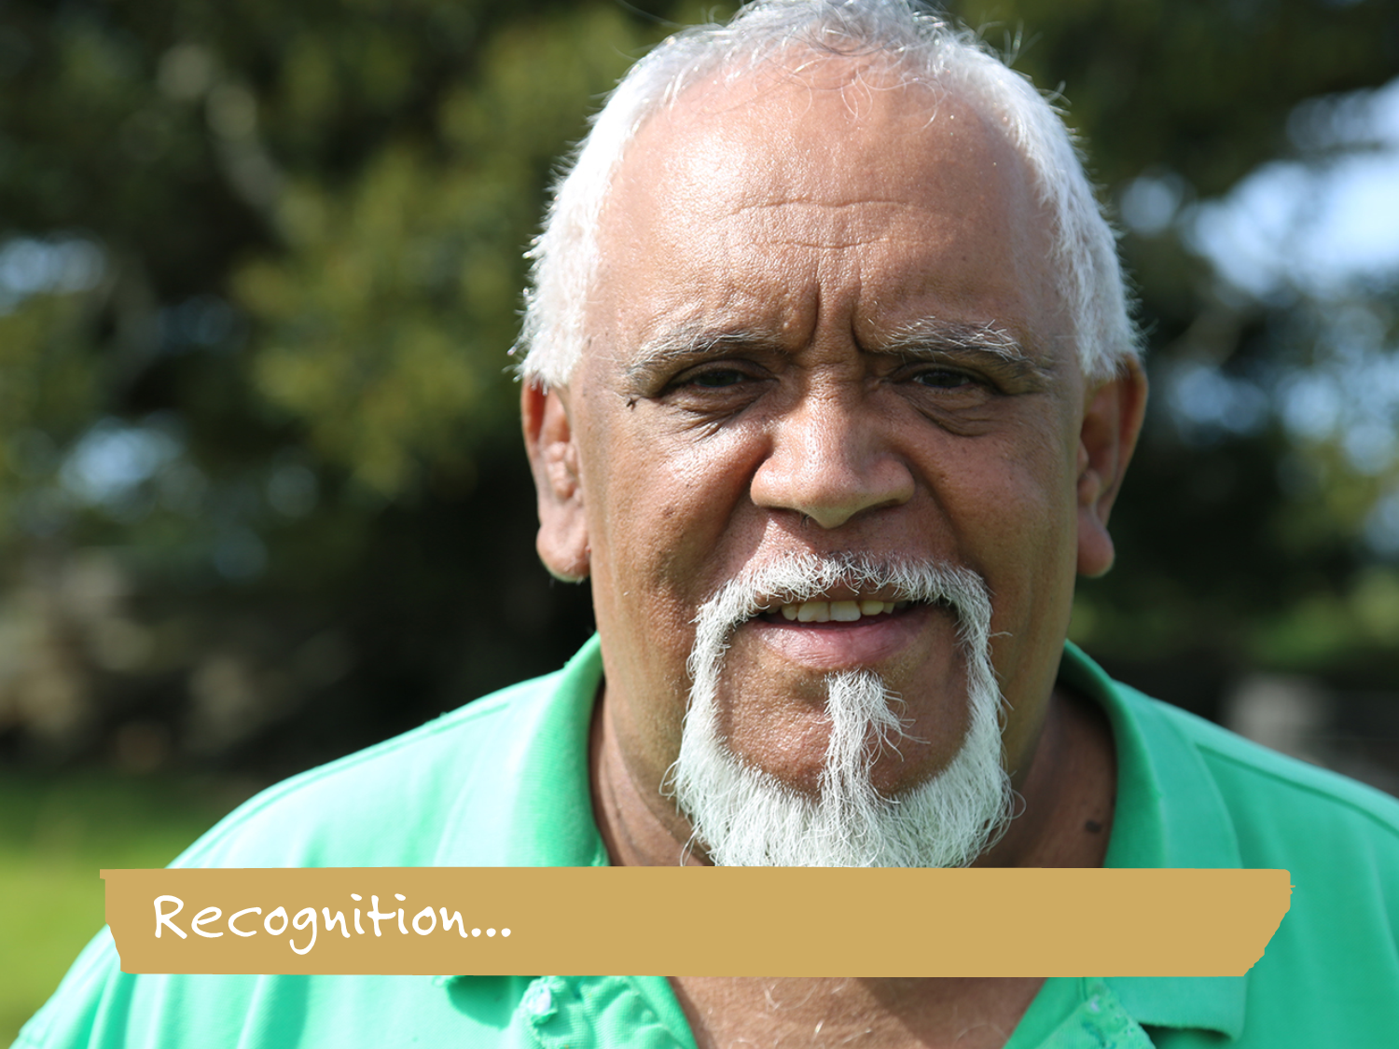
Photo Credit: Nicole Clements
Notes:
Uncle Richard. Kinchela Boys Home (KBH) Survivor, Uncle Richard.
http://www.caritas.org.au/projectcompassion/weekly-stories/week-3-uncle-Richard

Slide 17
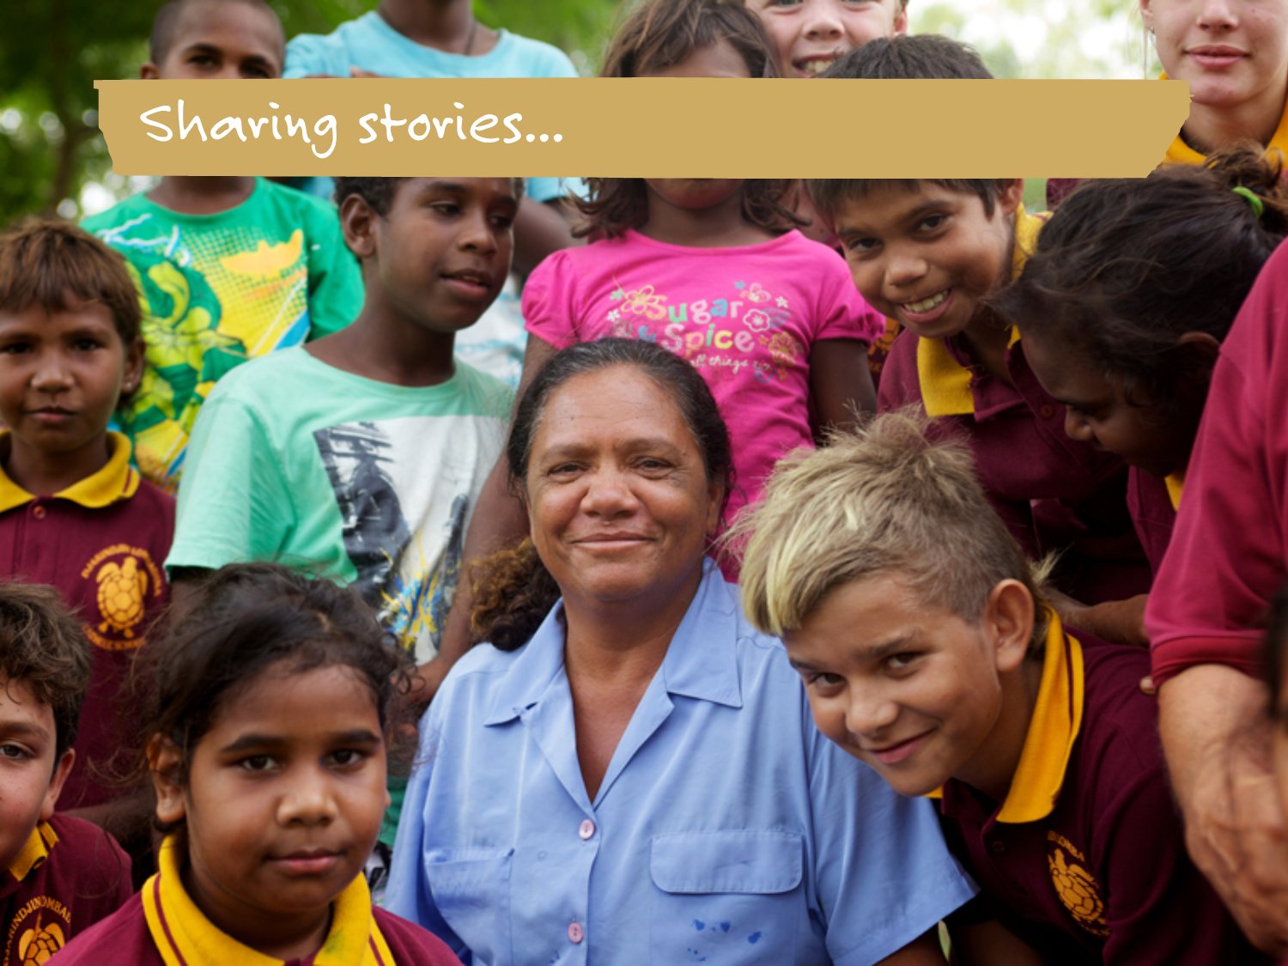
Photo Credit: Caritas Australia
Notes:
Audrey and kids from the Diabetes Management and Care program.
With an emphasis on the dignity of wellness, the Diabetes Management and Care program strives to prevent diseases like diabetes and to improve healthcare across Djarindjin and eight other remote communities across the Kimberley region. School breakfast programs managed by teachers and parents, and diabetes and nutrition education programs are some of the initiatives provided to kids in the program.

Slide 18
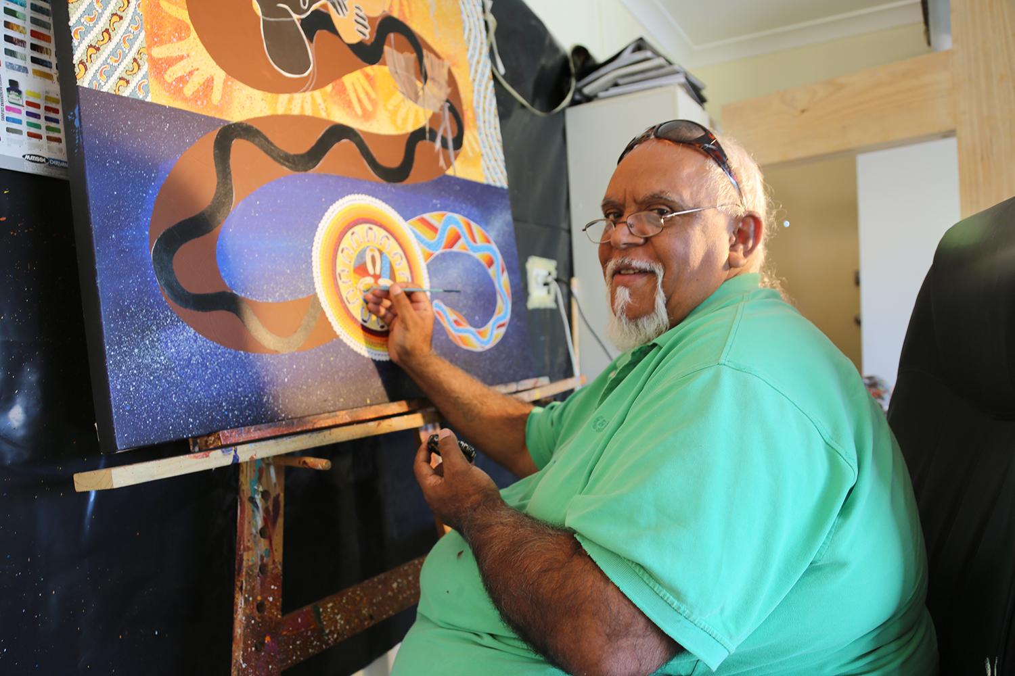

Photo Credit: Nicole Clements
Notes:
Kinchela Boys Home (KBH) Survivor, Uncle Richard working on his painting of the Good Samaritan at his art studio in Kempsey. Uncle Richard says “With the Good Samaritan, I believe a lot of indigenous people, over the years, during traditional times, helped a lot of people, helped a lot of non-indigenous people”.
http://www.caritas.org.au/projectcompassion/weekly-stories/week-3-uncle-Richard

Slide 19
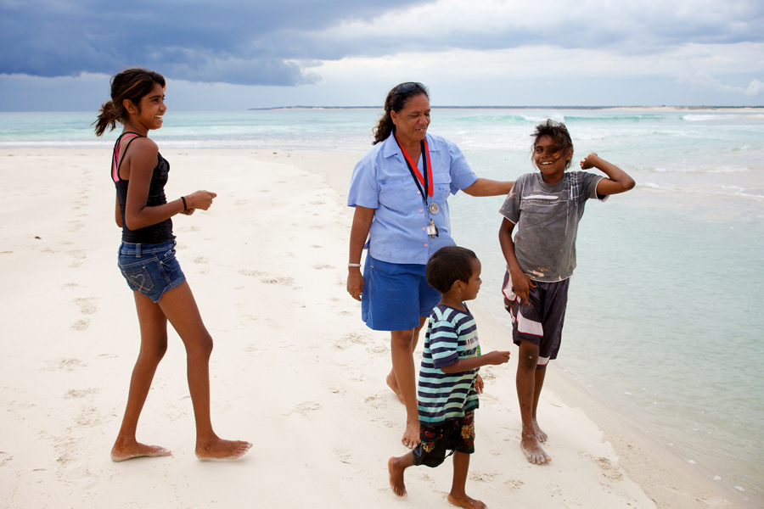

Photo Credit: Caritas Australia
Notes:
Audrey and kids enjoy some leisure time at the beach.
All nine communities supported by Caritas Australia and Unity of First People of Australia (UFPA) have seen sustained behaviour changes. Increasingly, the community stores are stocking healthy food choices, communities are embracing new leisure and sports initiatives, and the Elders are regaining their place a community leaders.

Slide 20
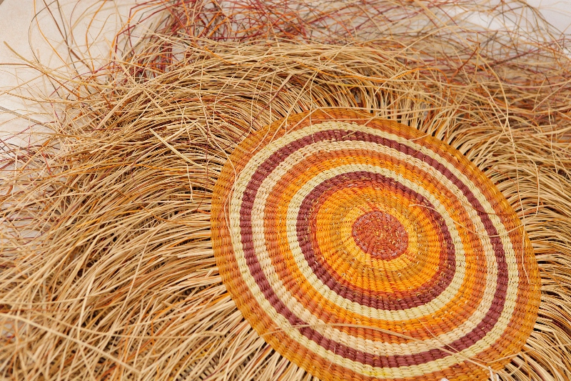

Photo Credit: Danielle Lyonne
Notes:
Weaving produced as part of the Djilpin Arts Ghunmarn Culture Centre, supported by Caritas Australia.

Slide 21
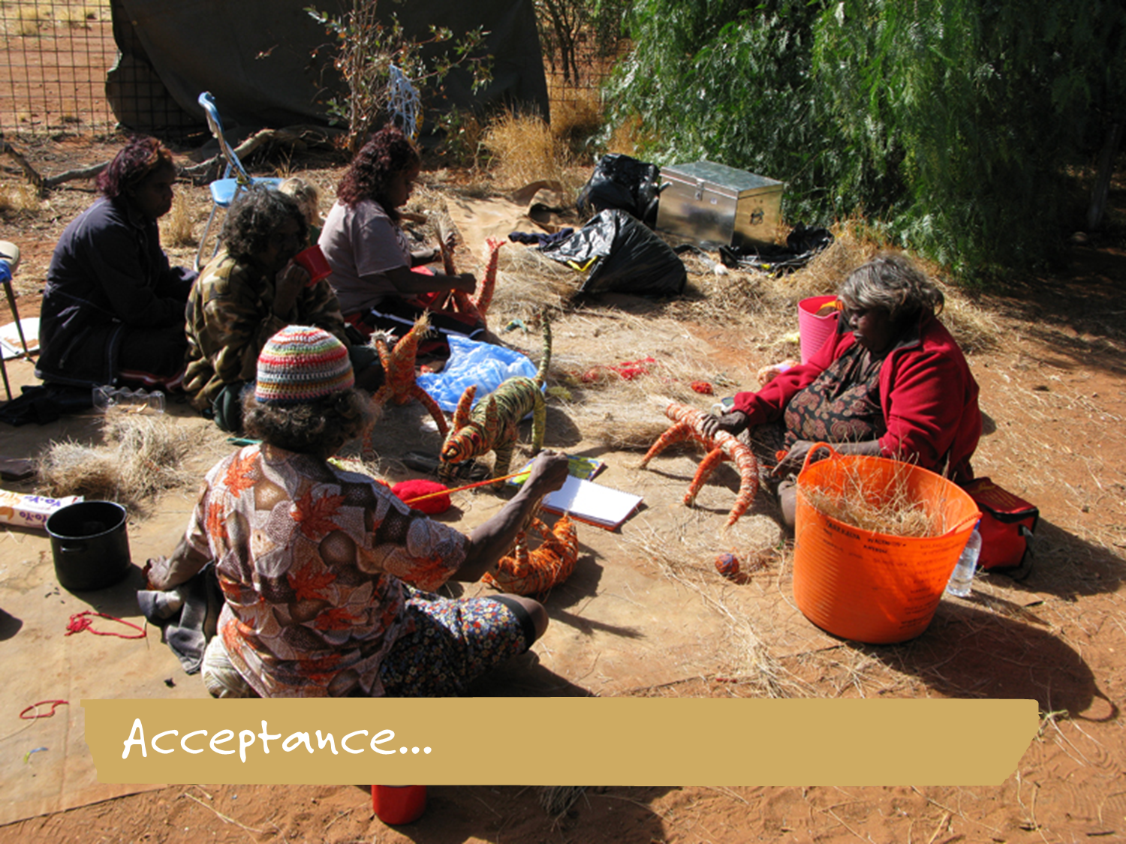
Photo Credit: Caritas Australia
Notes:
Tjanpi Desert Weaving
Tjanpi Desert Weavers draw on traditional weaving practices to support livelihoods. Here, Jennifer Mitchell, Yangi Yangi Fox, Renee Fox and Nyanu Tjanpi weave beautiful crafts.

Slide 22
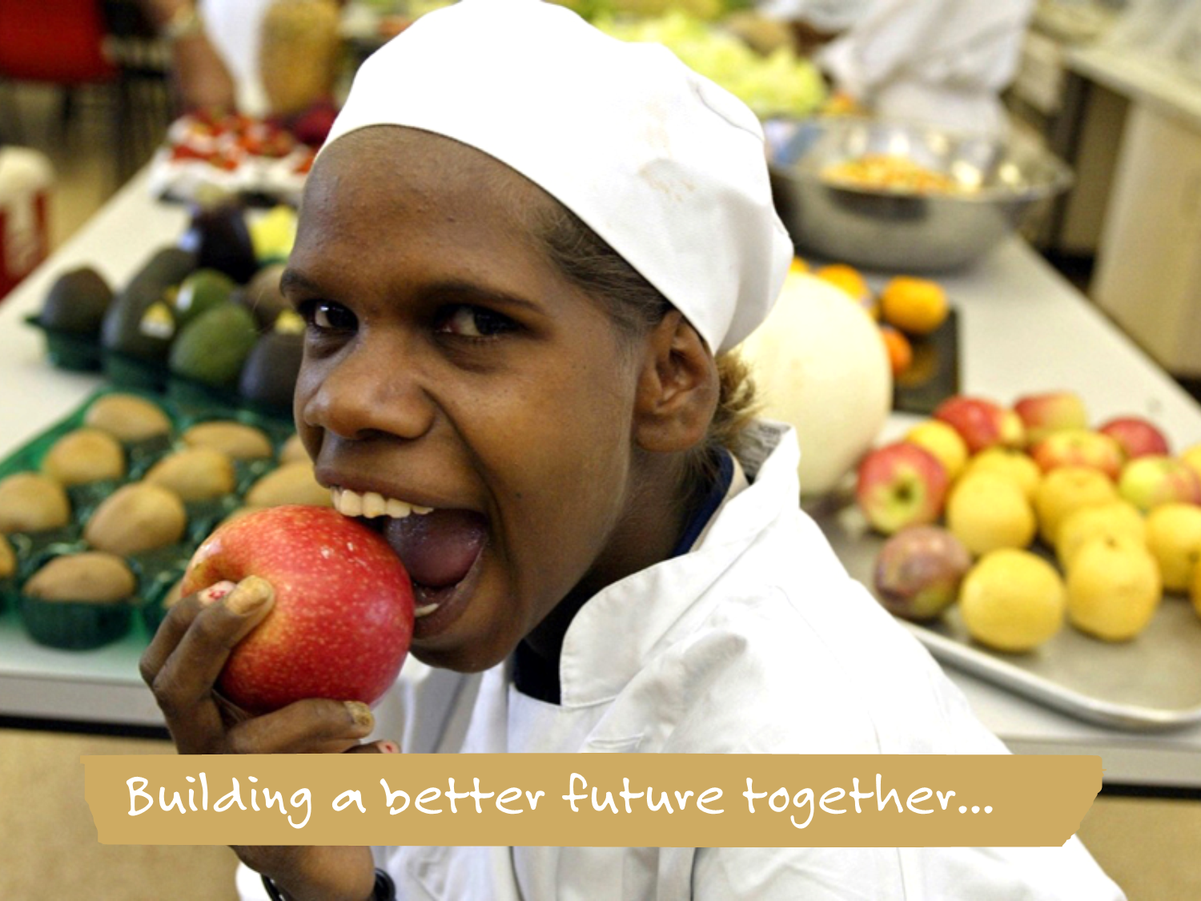
Photo Credit: Caritas Australia
Notes:
Promoting Good Food and Health.
Good health and nutrition are commonly encouraged in many of Caritas Australia's Indigenous Australian community development programs.

