Slide 1
Completing the ECSI Survey
Western Deanery Schools
7th February 2023

Slide 2
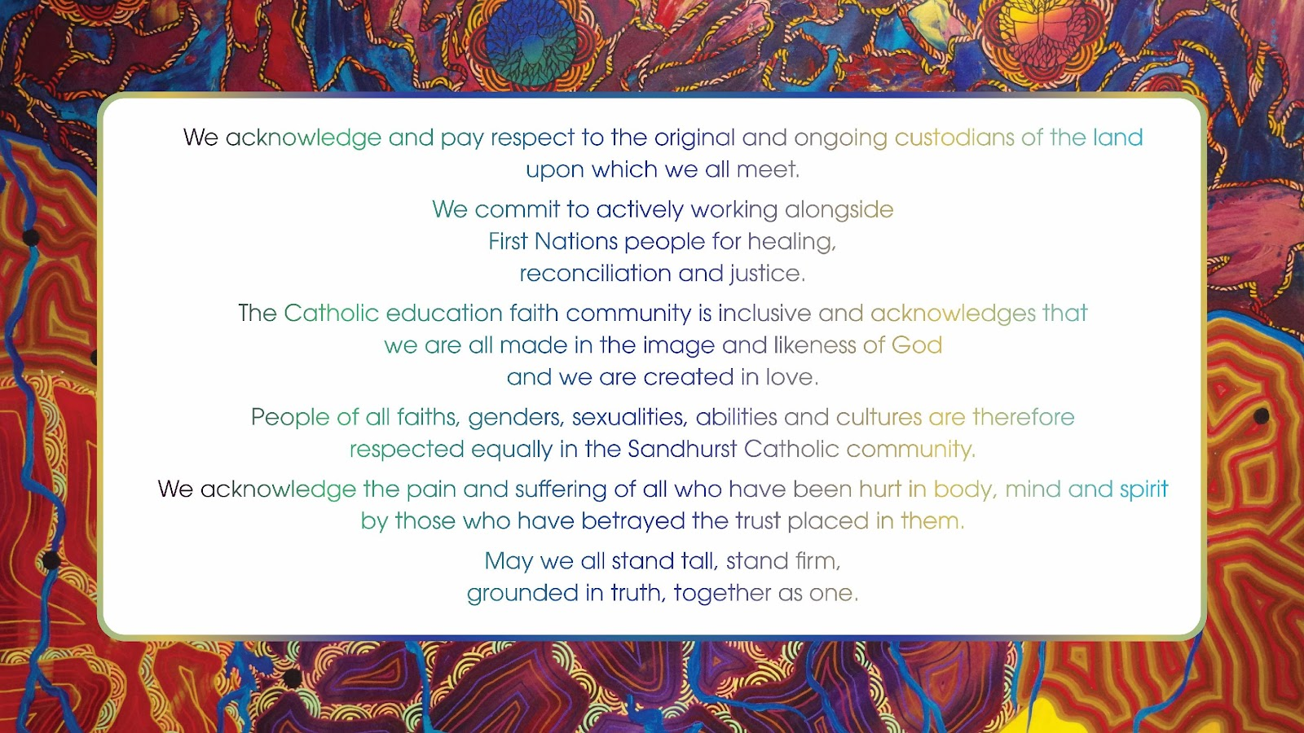

Slide 3
Morning Prayer
Let us prepare ourselves ...

Slide 4
“Enlarge the space of your tent”
Isaiah 54:2
Working Document for the Continental Stage
of the Synod 2021-2024

Slide 5
27. Listened to today, these words of Isaiah invite us to imagine the Church similarly as a tent, indeed as the tent of meeting, which accompanied the people on their journey through the desert: called to stretch out, therefore, but also to move. At its centre, stands the tabernacle, that is, the presence of the Lord. The tent’s hold is ensured by the sturdiness of its pegs, that is, the fundamentals of faith that do not change but can be moved and planted in ever new ground, so that the tent can accompany the people as they walk through history. Finally, in order not to sag, the structure of the tent must keep in balance the different forces and tensions to which it is subjected: a metaphor that expresses the need for discernment. This is how many reports envision the Church: an expansive, but not homogeneous dwelling, capable of sheltering all, but open, letting in and out.

Slide 6
Preserving the Tradition
Mark 7: 1-13

Slide 7
Gospel Reflection
Throughout their history God had indeed called the Jewish people to recognise and to experience being especially loved. The purpose of that call, however, was so that they could learn to speak with passion about it to all others who were also similarly loved but did not yet know it.
The Jews in the Markan community needed clear reassurance that Jewish separateness was no longer something to be preserved at all costs. Gentiles needed to be and to feel welcome in the community of disciples.
John McKinnon

Slide 8
Do I let the “rules” get in the way of caring for others?
How do I make others feel welcome in my community?
In terms of faith, what am I passing on to others?
How?
How am I called to “expand my tent”?

Slide 9
Welcome & Introductions
Dr Chris Hayes
Notes:
Why ECSI?
- Provides a clear way to look at our Catholic Identity (CI)
shows how we can grow our Mission and our being open to that
Leads us in being authentic

Slide 10
Our Vision
We Believe
• that the values of the Gospel are central to who we are, what we do and how we act.
• that we have a vital role in the mission of the Catholic Church to imagine and seek new horizons while respecting our Tradition.
• that a strong sense of community is dependent on the quality of our collegial relationships.
• that each person’s potential is fostered through the dedicated ministry of Catholic Education.
• in leadership encompassing vision, innovation and empowerment.
Notes:
The CES Ltd Vision gives the context for ECSI and what we are trying to achieve

Slide 11
Catholic Identity
  at the heart of all we do in Sandhurst
  presents a contemporary understanding of faith which energises and inspires a deep understanding of ourselves, of life and of our relationship with God
  commits to community and to spirituality
  takes Jesus and the Gospel seriously
Notes:
These statements come from CoSSI. They summarise what is at the heart of Catholic Identity.
At the same time we know that the world in which we live often challenges us in our articulation and lived expression of Catholic Identity.

Slide 12
CESL Vision & Mission enacted by ...
Nurturing and developing a distinctive Catholic identity and ethos which forms people for mission;
Offering an approach to life that is sacramental and hope-filled;
Developing education communities that foster dialogue, cooperation, collaboration and awareness of both responsibilities and rights;
Sandhurst Diocesan Charter for Catholic Education
Notes:
Catholic school communities understand education as nurturing the flourishing and developing of the whole person, who is created in the image of God and who is therefore fundamentally related to others, to the whole of creation, and to God.
All involved in Catholic education are actively invited to a personal encounter with Jesus, which is nourished by the Scriptures and celebrated in the faith and worship of the Christian community.

Slide 13
CESL Vision & Mission enacted by ...
Forming and encouraging leaders to operate with discernment in the context of servant leadership;
Exercising sound stewardship and management of resources; and
Engaging closely with parents/carers who are co-partners and the first educators of their children
Sandhurst Diocesan Charter for Catholic Education

Slide 14
Our Current Context
A decline in the influence of religion
= Secularisation
A multiplicity of narratives
= Pluralisation
Each person creating their own narrative for themselves
= Detraditionalisation
Notes:
We respond based on ECSI to find common ground in these diverse contexts

Slide 15
OUR RESPONSE USING ECSI

Slide 16
The Preferred Stance
ECSI, supported by research from KU Leuven, advocates the development of Catholic schools that work to facilitate the growth in students of post-critical belief through the presentation of a recontextualised Catholic heritage in dialogue with otherness and with the pluralising context.
Notes:
In short, the development of recontextualising dialogue schools that promote post-critical belief.

Slide 17
Post Critical Belief
- God is never experienced directly but always mediated through symbols (eg stories, rituals, prayer)
- faith is acquired through active, creative and interpretative engagement with these mediations - always within a faith community
- belief is only meaningful and possible after interpretation (in which critical reason plays a vital role)

Slide 18
Post Critical Belief
- religious answers are never definite, final or fixed - no absolute certainty, consistency or clarity in matters of faith
- faith is a complex and vulnerable life stance
- faith is a journey that is never complete

Slide 19
Who Am I to Judge?
“On that occasion I said this: If a person is gay and seeks out the Lord and is willing, who am I to judge that person? I was paraphrasing by heart the Catechism of the Catholic Church where it says that these people should be treated with delicacy and not be marginalised.
... before all else comes the individual person, in his wholeness and dignity.
People should not be defined only by their sexual tendencies: let us not forget that God loves all his creatures and we are destined to receive his infinite love.”
Pope Francis, “The Name of God is Mercy” 2016

Slide 20
Who Am I to Judge?
“It is possible that in an objective situation of sin a person can be living in God’s grace, can love and can also grow in the life of grace and charity, while receiving the Church’s help to this end ... For this reason, a minister cannot feel that it is enough simply to apply moral laws to those living in ‘irregular’ situations, as if they were stones to throw at people’s lives.” Amoris Laetitia, n.305

Slide 21
Recontextualisation
Put something existing into a new context and allow new things to happen, e.g. new baby, renovating
Fusing old / traditional and new / contemporary contexts
Transforming the understanding of both

Slide 22
Recontextualisation
- purposefully seeking a renewed, reinterpreted Christian profile within our plural context
- the Christian tradition develops as the (cultural etc) context changes
- not built on consensus but driven by multiplicity and difference

Slide 23
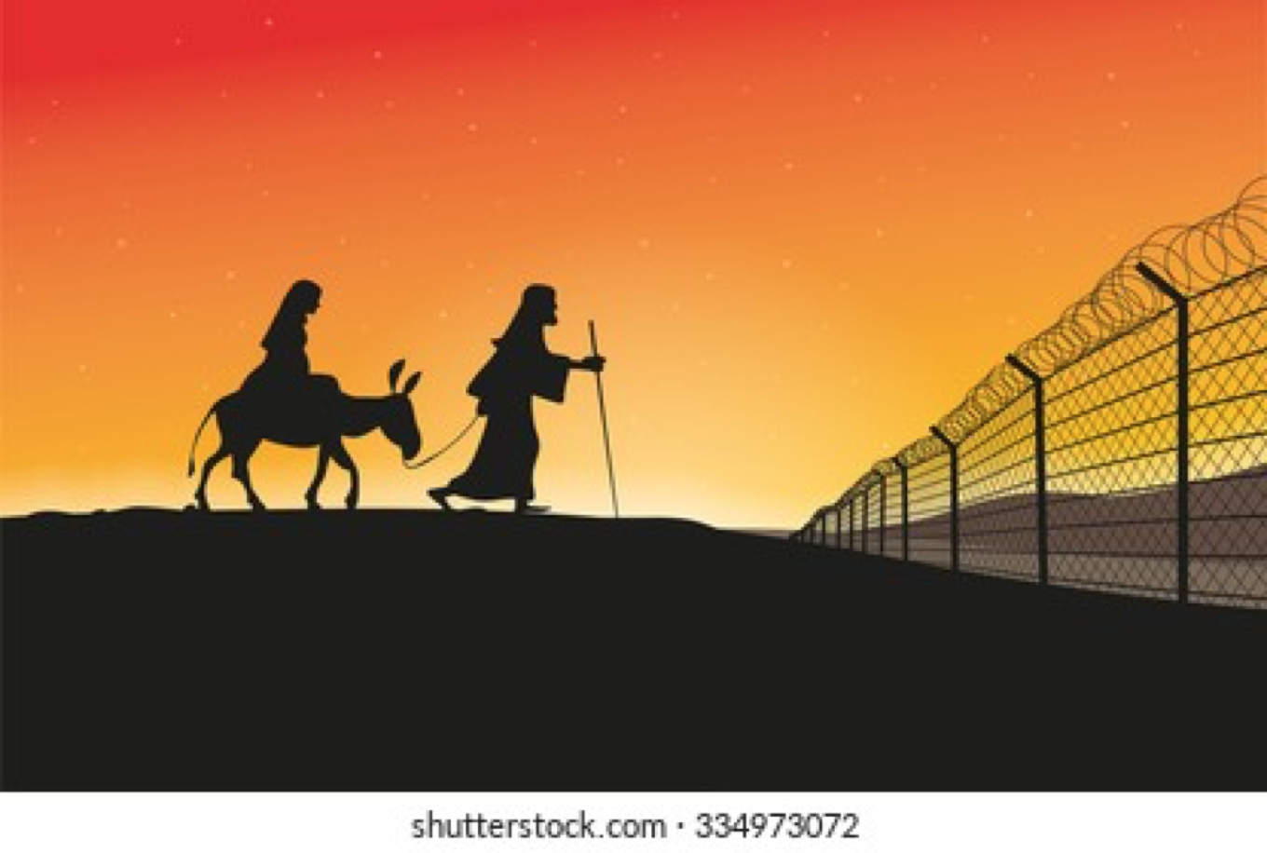
Recontextualisation
Notes:
Lee

Slide 24
Recontextualisation
Notes:
Lee

Slide 25
Recontextualisation
Notes:
Lee

Slide 26
Recontextualisation
– School Examples
Contemporary
Linking the Tradition with Life
Need to be pointed out and their stories told - repeatedly
Notes:
CMC – entrance to Marian Theatre
St Peters – boat in foyer – indigenous children in it with St Peter
HR Heathcote – plan to have outdoor learning spaces linked a la rosary beads
Marist – students rewrote Magnificat for contemporary context; Marcellin’s seat
St Francis of the Fields – Easter liturgy – stations of the cross recontextualised

Slide 27
Recontextualisation
Recontextualisation in a Religious Education classroom seeks to situate the Christian narrative within the rich diversity of fundamental life options evident in the lives of the students with a view towards bringing the particular Christian tradition to life. Pollefeyt (2008)

Slide 28
Recontextualising Pedagogy Project: Findings
Recontextualisation needs to become a pervading attitude amongst RE teachers.
Recontextualisation involves being creative, taking risks and even failing occasionally.
Frequent opportunities to collaboratively plan with colleagues are essential.
Notes:
Collaborative planning very important in developing theology of individuals and team

Slide 29
Recontextualising Pedagogy Project: Findings
Student voice and student agency are essential elements of a dialogical classroom.
Emphasis on content diminishes in favour of focus on creating dialogical forums.
Appropriate questioning techniques are essential.
Fine line between kerygmatic and recontextualising dialogue.

Slide 30
Dialogue
Dialogue is born from a respectful attitude toward the other person, from a conviction that the other person has something good to say. It supposes that we can make room in our heart for their point of view, their opinion and their proposals. Dialogue entails a warm reception and not a preemptive condemnation. To dialogue, one must know how to lower the defenses, to open the doors of one’s home and to offer warmth.
(Pope Francis “On Heaven and Earth” Image, NY 2013)
Notes:
Dialogue has a particular meaning in this context. Current capacity of staff reducing due to both decreasing knowledge and confidence

Slide 31
Source of Life Review 2017-2019
“We can have discussions about a topic instead of being told about them. In our RE class the teacher allows discussion: I like that.” (primary students)
The ideal Religious Education Teacher “creates a relaxed classroom and encourages discussion; is open, listens, encourages & respects students to share their opinions without passing judgement; and is interested in what we think.” (secondary students)
Making RE relevant to our students’ lives

Slide 32
Dialogue
In the midst of plurality we search for what it means to be Christian today; as Christians we search for a way to live in the middle of plurality.
People engage in conversations about different philosophies of life against the background of a preferential option for Christianity.
All are challenged to give shape to their personal identity through dialogue.
Notes:
In a dialogical classroom learners (including the adults at times) can voice their thinking / opinions / perspectives and be heard
Dialogue – acceptance of a wide range of worldviews – must be life-giving

Slide 33
Dialogue
(In Sandhurst we believe) it is essential that students are given agency as well as voice. Teachers can translate student voice into student agency by promoting dialogue and recontextualisation.
Dialogue is about openness and students knowing they can be heard.
In a spirit of dialogue, with the teacher as moderator, student perceptions of Religious Education change; they see it as not prescriptive or one-way but more of a forum.
Source of Life Core Document 2020
Notes:
Receptivity and openness to what is different are prerequisites to re-profile Catholic faith in the midst of a pluralising culture (Recontextualisation), ie Dialogue leads to Recontextualisation.

Slide 34
Shared Christian Praxis
Overarching Commitment
To create communities of conversation and participation to integrate Life and Faith
“Life to Faith, Faith to Life”
Notes:
Lee

Slide 35
Why ECSI?
ECSI assists schools to better understand how their Catholic Identity is expressed in practice and supports them in their future development.
The main questions being explored are:
• How is Catholic identity lived and shaped in the school?
• What is the preferred situation?
• What is the potential present in the school to realise its preferred Catholic Identity?
Notes:
Given our context (secularizing etc), the ECSI surveys provide us with data to use in our strategic planning and every aspect of our Catholic Identity
ECSI, supported by the KU Leuven research, advocates the development of Catholic schools that work to facilitate the growth and identity formation of all members of the school community. What do we stand for? What do we believe? How do we shape our lives? How can the Catholic tradition, which has inspired and motivated generations before us, do the same today?
The growth and identity formation process in a Catholic school today is enabled by the development of post-critical belief, and happens through the presentation of a recontextualised Catholic heritage in dialogue with otherness in a pluralising context.

Slide 36
BREAK

Slide 37
The Survey
4 parts
Doyle questionnaire
Post Critical Belief, Melbourne & Victoria Scales
Notes:
Lee

Slide 38
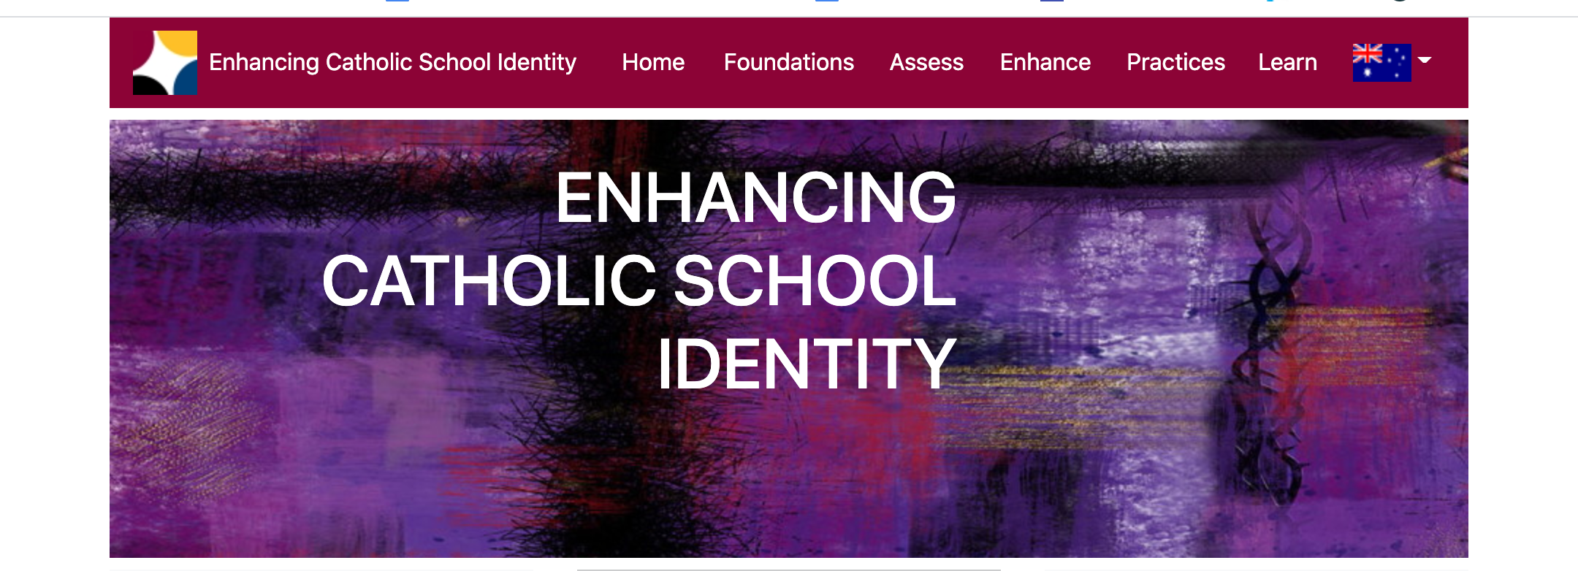
ECSI Website (www.ecsi.site/au/)

Slide 39
The Survey - Adults
Introduction (profile questions)
4 parts
Doyle Questionnaire
PCB Scale
Melbourne Scale
Victoria Scale
Notes:
Strategies to engage parents (very difficult – many schools have chosen not to bother):
Maintain an encouraging presence in school foyer during survey period
Open a computer room (eg library)
Raffle with prize/s
Morning tea and support to complete survey

Slide 40
Doyle Questionnaire
Example Questions: (Current & Ideal)
  In my school people believe in God
  In my ideal school, people believe in God
  It is easy to ignore my school’s Catholic identity
  I prefer to ignore a school’s Catholic identity
  Features of Catholic Identity (more / same / less)
  Using the Scriptures at school
  Knowledge about the Catholic religion

Slide 41
The 3 ECSI Scales
  Post Critical Belief Scale:
  Personal and Professional Spirituality.
  Melbourne Scale:
  How to deal with the context of diversity?
  Victoria Scale:
  How to deal with the tradition?

Slide 42
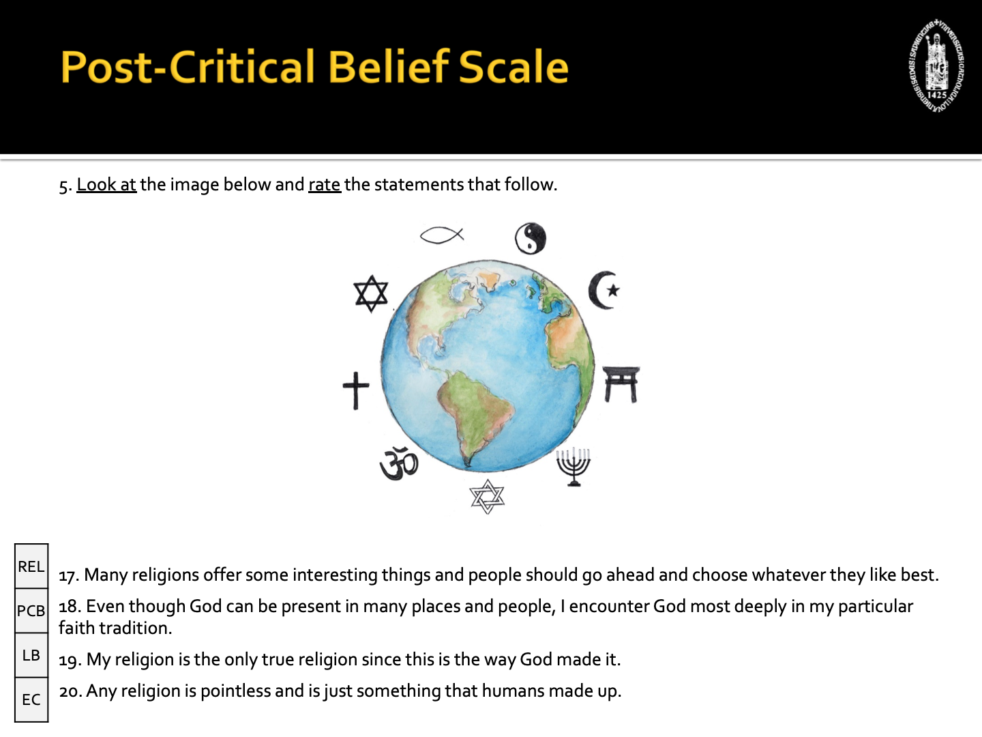
Same for adults & students

Slide 43
Adult Survey
Like the Doyle Scale, Melbourne and Victoria Scales ask Current & Ideal questions about:
  Melbourne Scale – approx. 21 question pairs
  Victoria Scale – approx. 20 question pairs
Notes:
Best strategy to engage teachers is to use a staff meeting

Slide 44
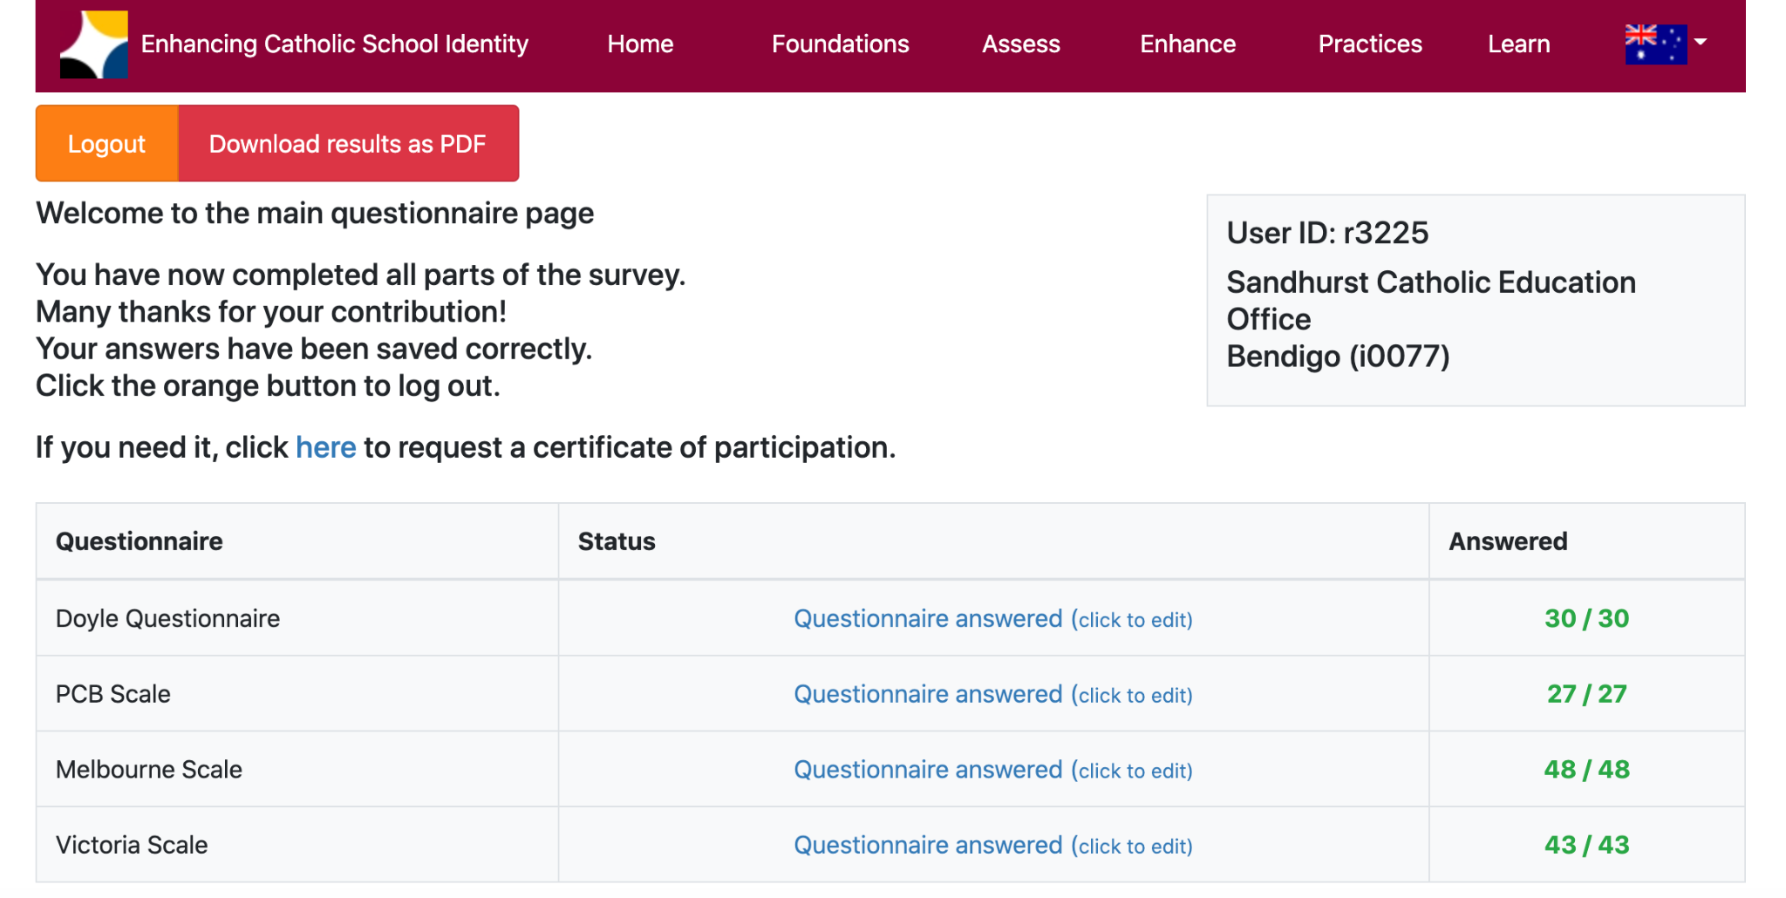
The Survey - Adults
:

Slide 45
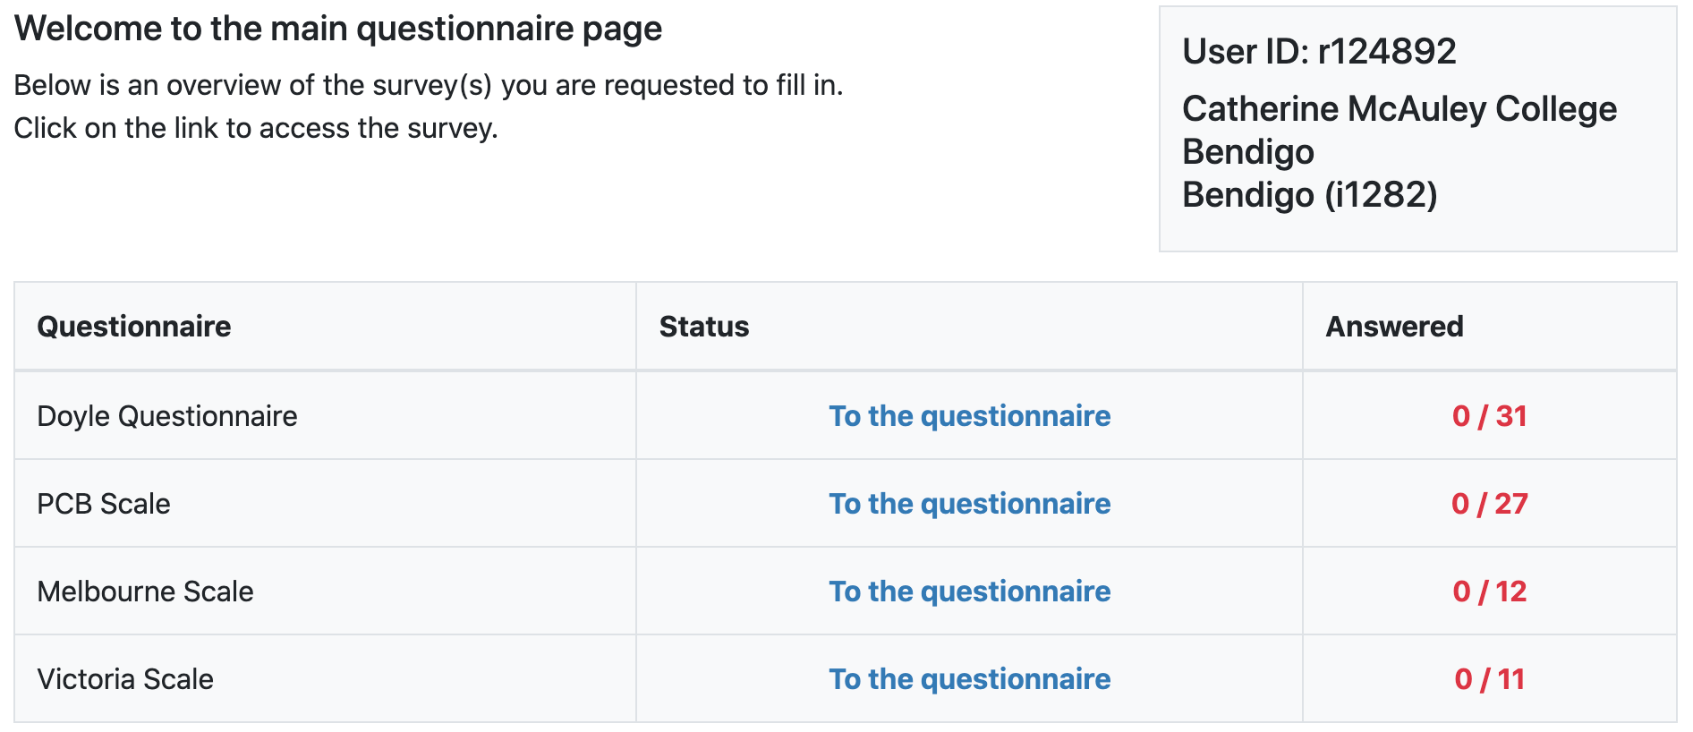

The Survey - Students
:

Slide 46
The 3 Scales
(For Students)
Note:
    - How the survey questions are presented
    - What are the potential challenges for students answering the questions? And how will you respond?

Slide 48
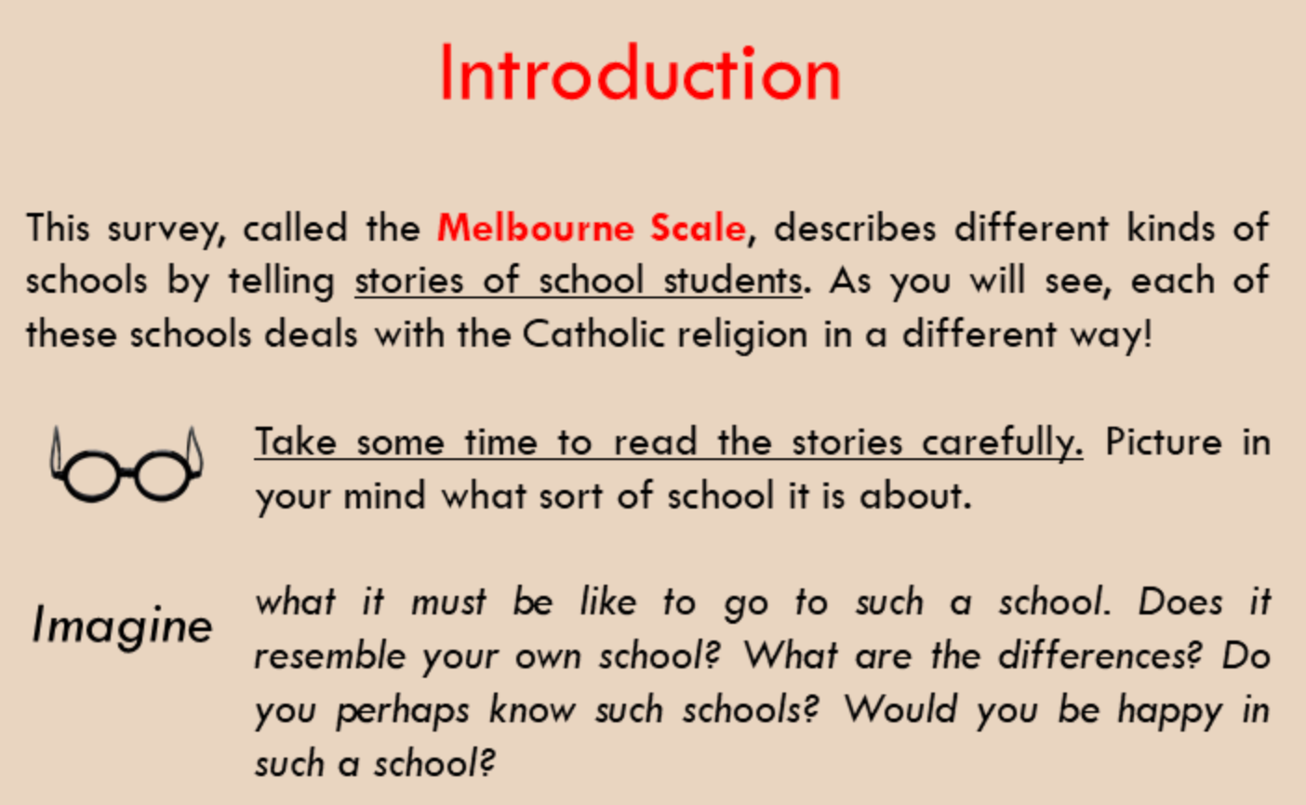
MELBOURNE SCALE

Slide 49
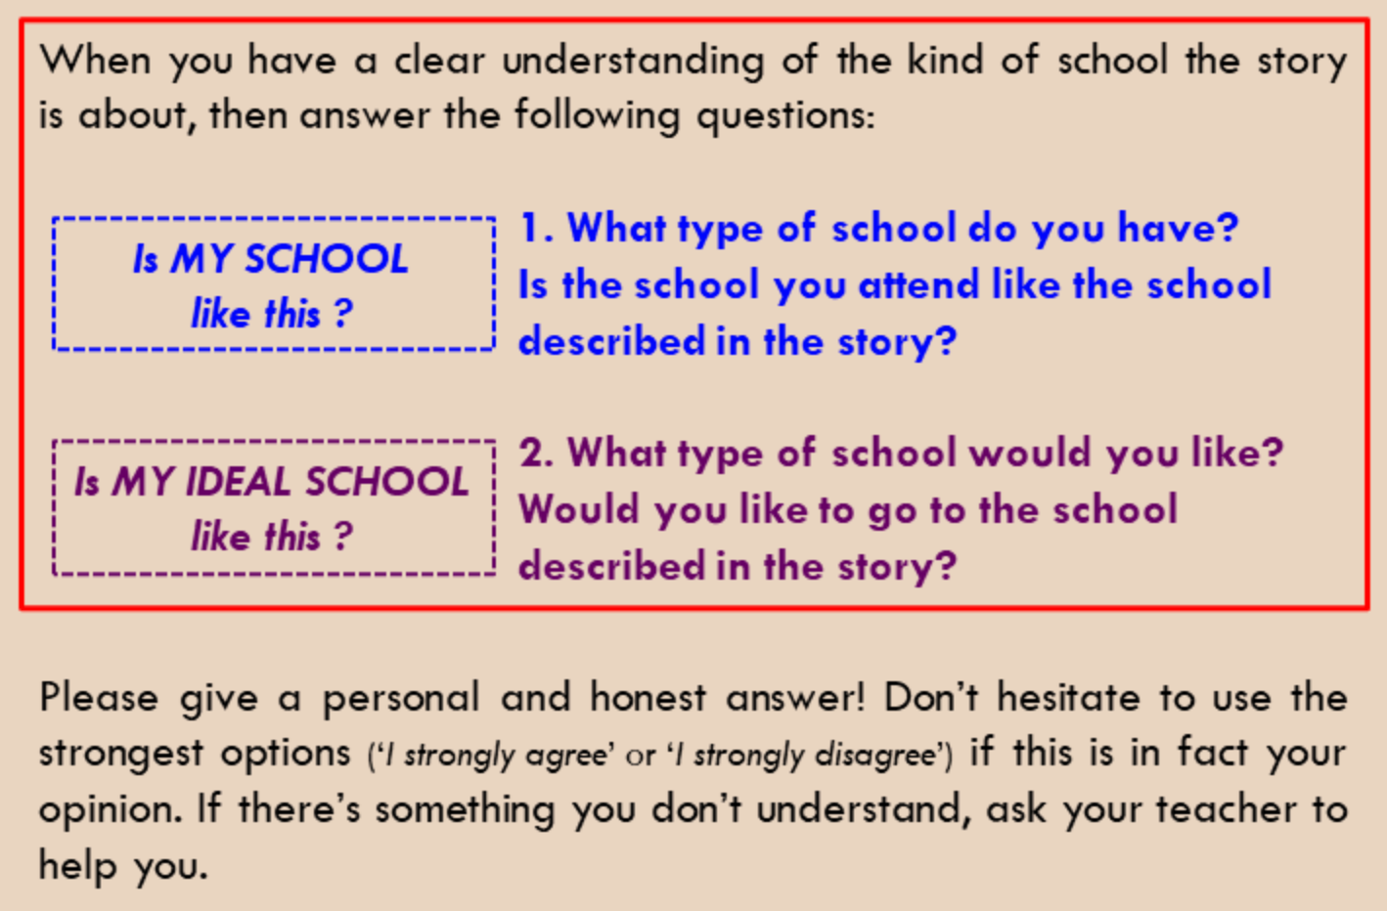
MELBOURNE SCALE

Slide 50
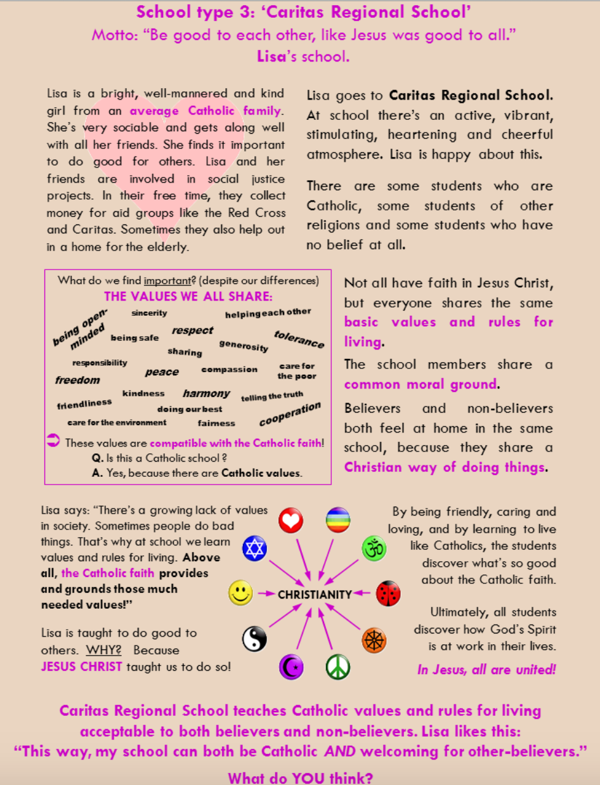
MELBOURNE SCALE
2 Questions
Is the school you attend like the school described in the story?
Would you like to go to the school described in the story?
Notes:
Text dense – only need to read top half of each page; some students will only need to read images and/or bold/ colourful words

Slide 51
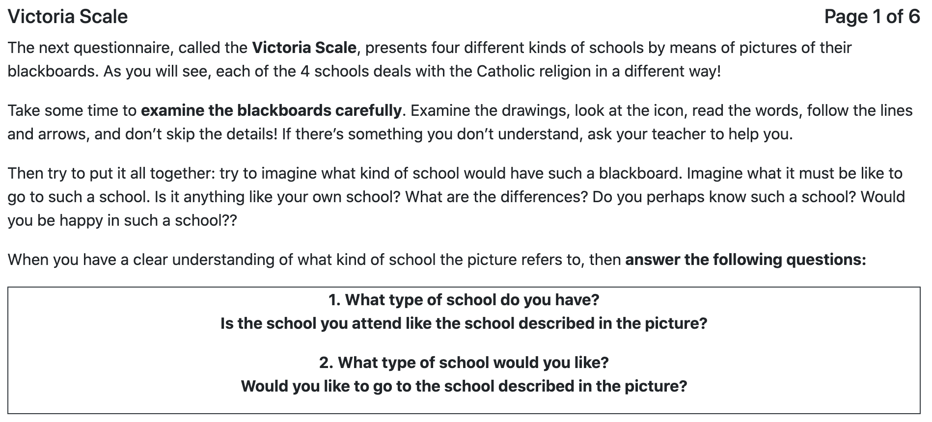
VICTORIA SCALE

Slide 52

VICTORIA SCALE
2 Questions
Is the school you attend like the school described in the story?
Would you like to go to the school described in the story?

Slide 53
The 3 Scales
(For Students)
Discuss:
    - How the survey questions are presented
    - What are the potential challenges for students answering the questions? And how will you respond?
Notes:
Essential that every survey goer screenshot / photograph / write down their user ID and password to re-enter survey
Strategies to use with students – especially to avoid the drop off / incomplete surveys:
Years 9-12 can complete in one long/double lesson (some may need finishing off time in next lesson)
Years 5-8 should complete the survey in 2-4 shorter sessions

Slide 54
Points to Remember
Consider when / how survey will be presented to each cohort. Get in early
Leaders (and teachers) go first
Avoid the drop off (Melb + Vic Scales) – children to do the survey in parts - use the password to return and complete survey
Don’t overthink the response…Go with your gut!
Notes:
Essential that every survey goer screenshot / photograph / write down their user ID and password to re-enter survey

Slide 55
The ECSI Plan - Procedure
1. Registration – completed for you
2. Professional Learning to prepare for the surveys – today
3. Survey completion – staff / students / parents – Feb 13 to April 6
4. Standard Reports issued – by October
5. (With CES support) Schools break open & unpack their data
6. Schools submit an ECSI Implementation Plan - template supplied
7. School strategic & annual plans re Catholic Identity
Notes:
Try to complete before NAPLAN (March 19). Try to avoid last week of term. If needed extensions may be granted – contact David one week prior to end of term 1

Slide 56
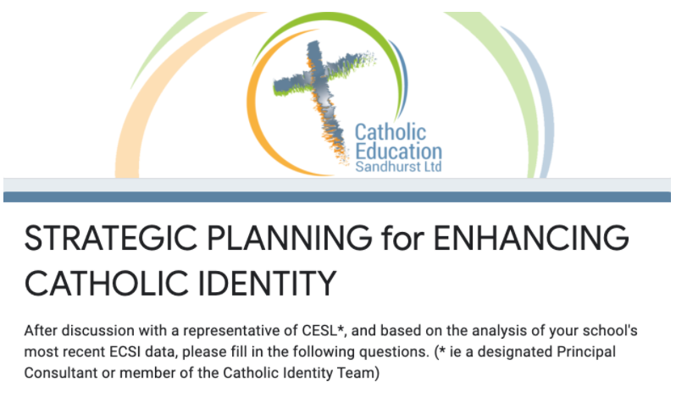
ECSI Implementation Plan - Template
Based on the analysis of your school’s ECSI data
Towards the ideal of a Recontextualising Catholic Dialogue School
Strengths
Challenges
1 / 2 Goals in CI
Submitted to Chief CMLT Officer
Notes:
First Implemented in 2021

Slide 57
Administering the Surveys
For principals & school survey administrators
(i) Access Password Klm321,
(ii) Group Code (school E number) and
(ii) Administrator Password (6 random letters / numbers)
provides sample sizes; real-time completion rates; etc

Slide 58
Administering the Surveys
Activity
Check your population numbers
make only significant changes (especially upwards)

Slide 59
Completing the Surveys
  General Access Password - to first enter the survey site
universal Ghj654
  Group Access Code - to begin the survey same for all at your school 6 random letters / numbers
  User ID + Password - to return to the survey unique to the individual WRITE IT DOWN

Slide 60
Completing the Survey
:

Slide 61
Sandhurst Catholic Identity Website
https://www.ceosand.catholic.edu.au/catholicidentity/ecsi
ECSI website
Completing the Surveys
About the Scales
For Leaders
The ECSI Guide
For Educators
ECSI Resources
Research
SPES
Notes:
ECSI website - to complete & administer surveys
Completing the Surveys - instructions and letters
About the Scales - diagrams, videos & summaries
For Leaders - ECSI Workbook & Strategic planning report form
The ECSI Guide
For Educators - resources, e.g. re recontextualisation
ECSI Resources - videos, articles & presentations
Research - e.g. Recontextualising Pedagogies Project
SPES - parish engagement

Slide 62
Conducting the Survey (15 mins)
Make a school plan
For staff - a staff meeting?
For students - which classes? which teachers?
For parents?
Discussion / shared wisdom
:
Notes:
Good luck!

